Slide 1
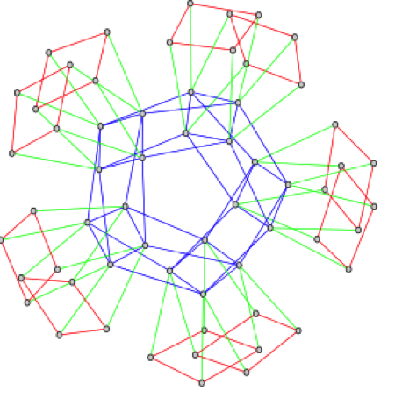
Supersingular Isogeny Cryptography
(signatures and Diffie-Hellman)

Slide 2
References
Costello, Longa, Naehrig. "Efficient Algorithms for Supersingular Isogeny Diffie-Hellman." Advances in Cryptology – CRYPTO 2016 Proceedings, Springer Berlin Heidelberg, 2016.
https://eprint.iacr.org/2016/413.pdf
Galbraith, Petit, Shani, Ti. "On the Security of Supersingular Isogeny Cryptosystems." Advances in Cryptology–ASIACRYPT 2016 Proceedings, Springer Berlin Heidelberg, 2016.
http://eprint.iacr.org/2016/859.pdf
Galbraith, Petit, and Silva. "Signature Schemes Based On Supersingular Isogeny Problems.“, 2016
http://eprint.iacr.org/2016/1154.pdf

Slide 3
History of isogeny-based crypto
2003 Teske - key escrow system
2006 Rostovtsev/Stolbunov – Key exchange, encryption
  2012 Stolbunov’s dissertation
2007 Charles, Goren, Lauter - hash function
2010 Childs, Jao, Soukharev - quantum attack on ordinary curves
2011 Jao, De Feo – SIDH
2011 Jao, De Feo, Plut – encryption, extended SIDH + implementation
2012 Xi, Tian, Wang – designated verifier signature scheme
2014 Azarderakhsh, Fishbein, Jao – implementation of SIDH
2014 Jao, Soukharev – isogeny based undeniable signatures
2016 Costello, Longa, Naehrig – state-of-the-art implementation of SIDH
2016 Galbraith et. al. – isogeny-based signature schemes

Slide 4
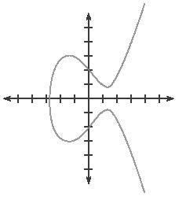
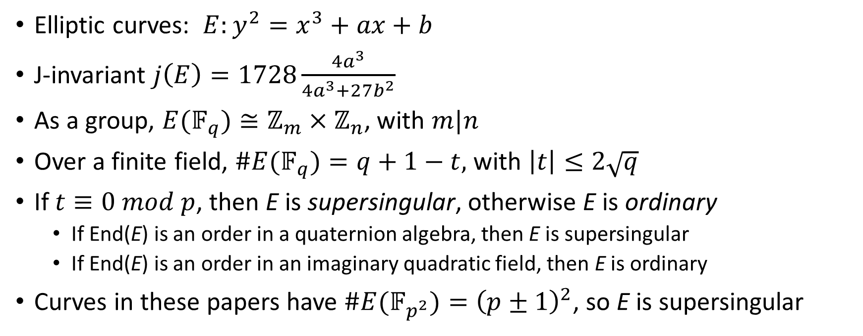
Background
Elliptic curves: $E:y^{2}=x^{3}+ax+b$
J-invariant $j\left(E\right)=1728\frac{4a^{3}}{4a^{3}+27b^{2}}$
As a group, $E(𝔽_{q})≅ℤ_{m}×ℤ_{n}$, with $m|n$
Over a finite field, $\#E(𝔽_{q})=q+1−t,$ with $\left|t\right|≤2\sqrt{q}$
If $t≡0 mod p$, then E is supersingular, otherwise E is ordinary
  If End(E) is an order in a quaternion algebra, then E is supersingular
  If End(E) is an order in an imaginary quadratic field, then E is ordinary
Curves in these papers have $\#E(𝔽_{p^{2}})={\left(p±1\right)}^{2}$, so E is supersingular

Slide 5
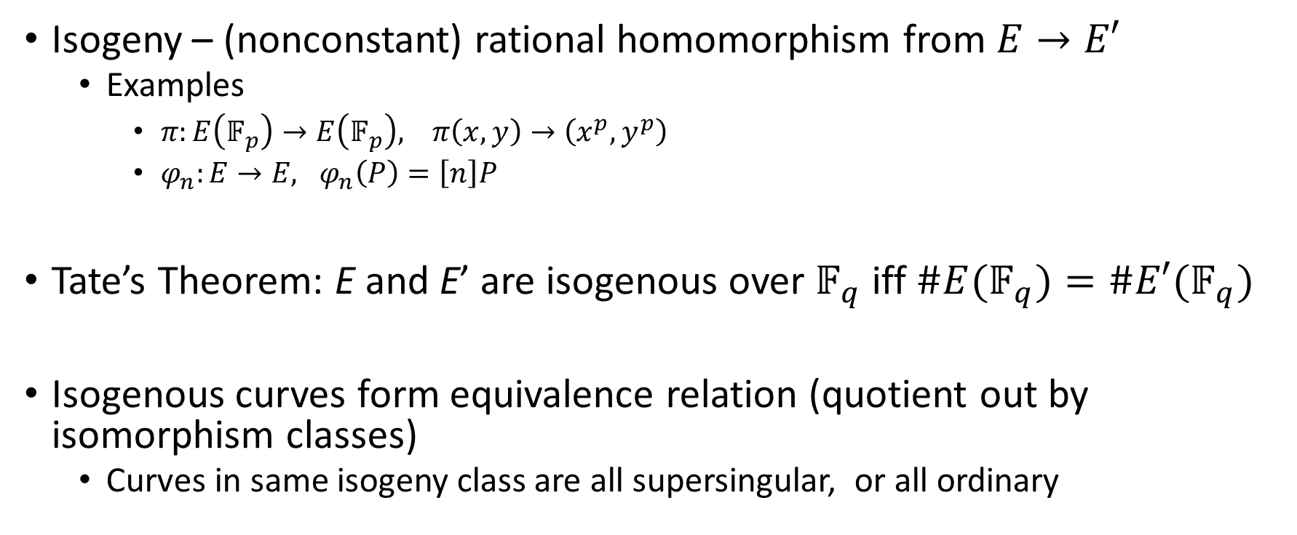
Isogenies
Isogeny – (nonconstant) rational homomorphism from $E→E′$
  Examples
    $π:E\left(𝔽_{p}\right)→E\left(𝔽_{p}\right), π\left(x,y\right)→\left(x^{p},y^{p}\right)$
    $φ_{n}:E→E, φ_{n}\left(P\right)=\left[n\right]P$
Tate’s Theorem: E and E’ are isogenous over $𝔽_{q}$ iff $\#E(𝔽_{q})=\#E′(𝔽_{q})$
Isogenous curves form equivalence relation (quotient out by isomorphism classes)
  Curves in same isogeny class are all supersingular, or all ordinary

Slide 6
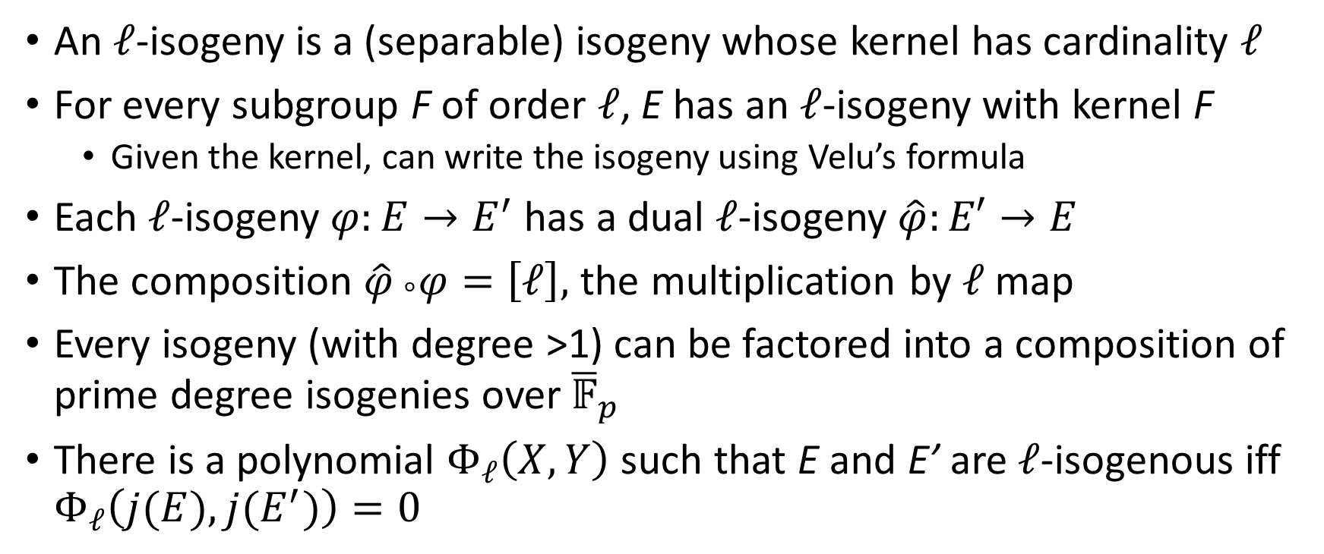
Isogeny Degrees
An $ℓ$-isogeny is a (separable) isogeny whose kernel has cardinality $ℓ$
For every subgroup F of order $ℓ$, E has an $ℓ$-isogeny with kernel F
  Given the kernel, can write the isogeny using Velu’s formula
Each $ℓ$-isogeny $φ:E→E^{′}$ has a dual $ℓ$-isogeny $\hat{φ}:E′→E$
The composition $\hat{φ} _{°}φ=\left[ℓ\right],$ the multiplication by $ℓ$ map
Every isogeny (with degree >1) can be factored into a composition of prime degree isogenies over ${\overline{𝔽}}_{p}$
There is a polynomial $Φ_{ℓ}\left(X,Y\right)$ such that E and E’ are $ℓ$-isogenous iff $Φ_{ℓ}\left(j(E),j(E^{′})\right)=0$

Slide 7
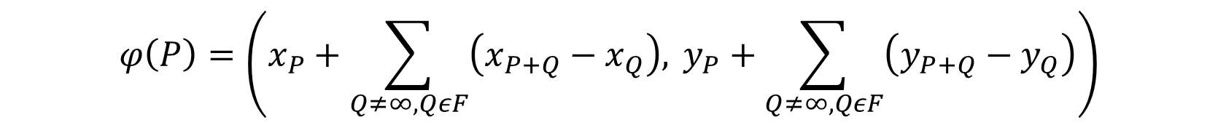
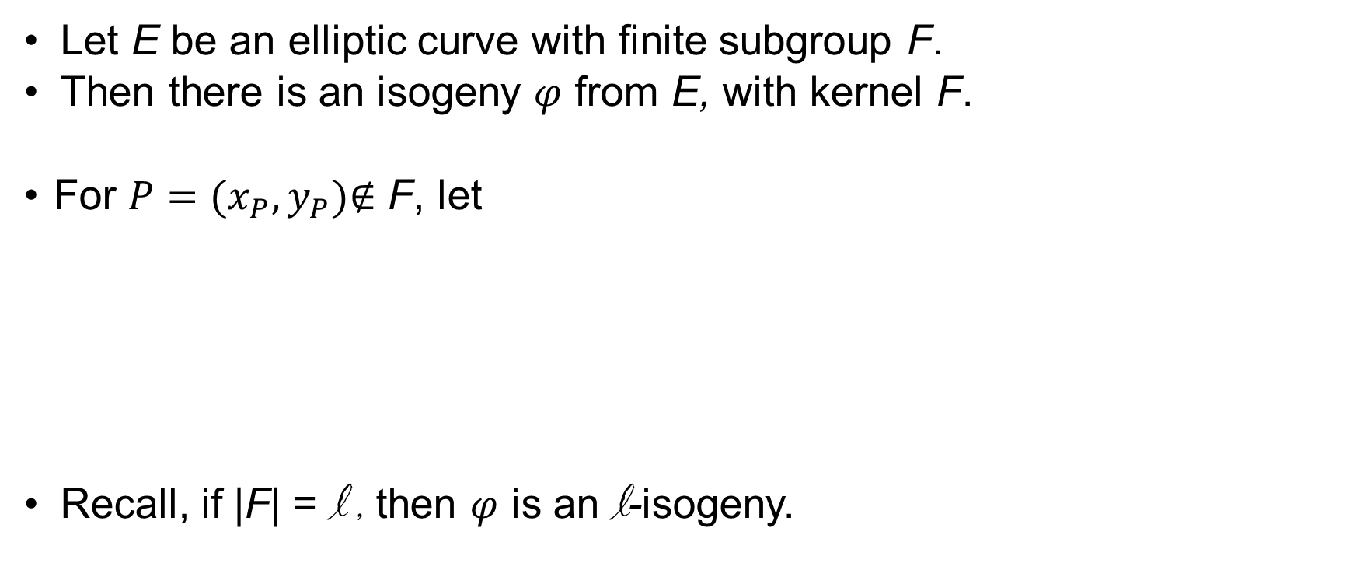
Velu’s Formula
Let E be an elliptic curve with finite subgroup F.
Then there is an isogeny $φ$ from E, with kernel F.
For $P=(x_{P},y_{P})\text{∉}$ F, let
Recall, if |F| = l , then $φ$ is an l-isogeny.
$$φ\left(P\right)=\left(x_{P}+\sum_{Q≠∞,QεF}{\left(x_{P+Q}−x_{Q}\right), }y_{P}+\sum_{Q≠∞,QεF}{\left(y_{P+Q}−y_{Q}\right)}\right)$$

Slide 8
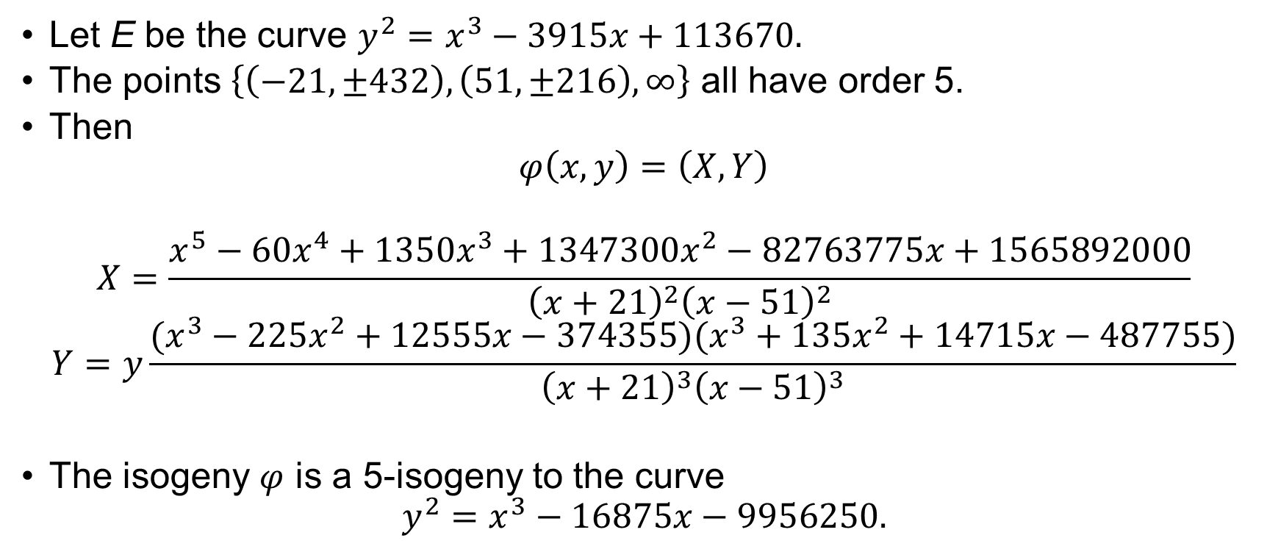
Velu’s Formula - Example
Let E be the curve $y^{2}=x^{3}−3915x+113670.$
The points $\left\{\left(−21,±432\right), \left(51,±216\right), ∞\right\}$ all have order 5.
Then
$$φ\left(x,y\right)=\left(X,Y\right)$$
$$X=\frac{x^{5}−60x^{4}+1350x^{3}+1347300x^{2}−82763775x+1565892000}{{\left(x+21\right)}^{2}{\left(x−51\right)}^{2}}$$
$$Y=y\frac{(x^{3}−225x^{2}+12555x−374355)(x^{3}+135x^{2}+14715x−487755)}{{\left(x+21\right)}^{3}{\left(x−51\right)}^{3}}$$
The isogeny $φ$ is a 5-isogeny to the curve
$$y^{2}=x^{3}−16875x−9956250.$$

Slide 9
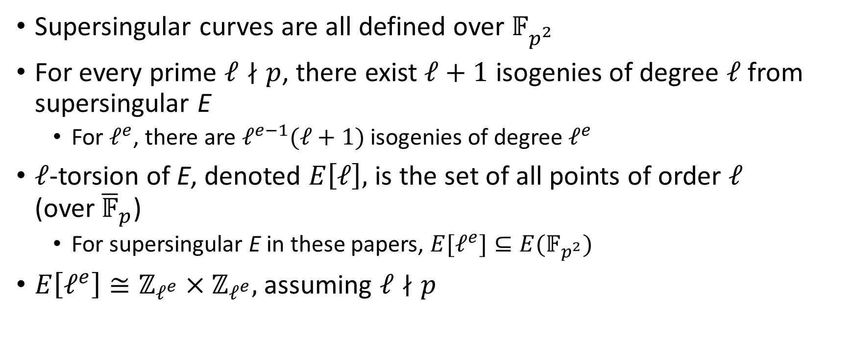
Supersingularity and isogenies
Supersingular curves are all defined over $𝔽_{p^{2}}^{ }$
For every prime $ℓ∤p$, there exist $ℓ+1$ isogenies of degree $ℓ$ from supersingular E
  For $ℓ^{e}$, there are $ℓ^{e−1}(ℓ+1)$ isogenies of degree $ℓ^{e}$
$ℓ$-torsion of E, denoted $E\left[ℓ\right],$ is the set of all points of order $ℓ$ (over${ \overline{𝔽}}_{p}$)
  For supersingular E in these papers, $E[ℓ^{e}]⊆E(𝔽_{p^{2}})$
$E\left[ℓ^{e}\right]≅ℤ_{ℓ^{e}}×ℤ_{ℓ^{e}},$ assuming $ℓ∤p$

Slide 10
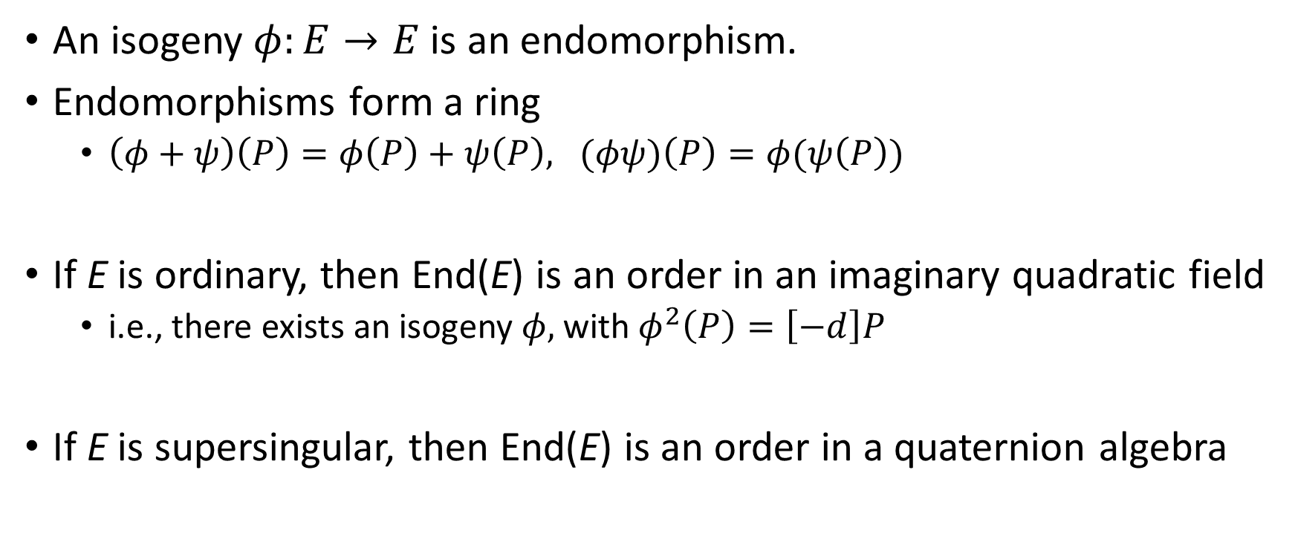
Endomorphism rings
An isogeny $φ:E→E$ is an endomorphism.
Endomorphisms form a ring
  $\left(φ+ψ\right)\left(P\right)=φ\left(P\right)+ψ\left(P\right), (φψ)\left(P\right)=φ(ψ\left(P\right))$
If E is ordinary, then End(E) is an order in an imaginary quadratic field
  i.e., there exists an isogeny $φ,$with $φ^{2}\left(P\right)=\left[−d\right]P$
If E is supersingular, then End(E) is an order in a quaternion algebra

Slide 11
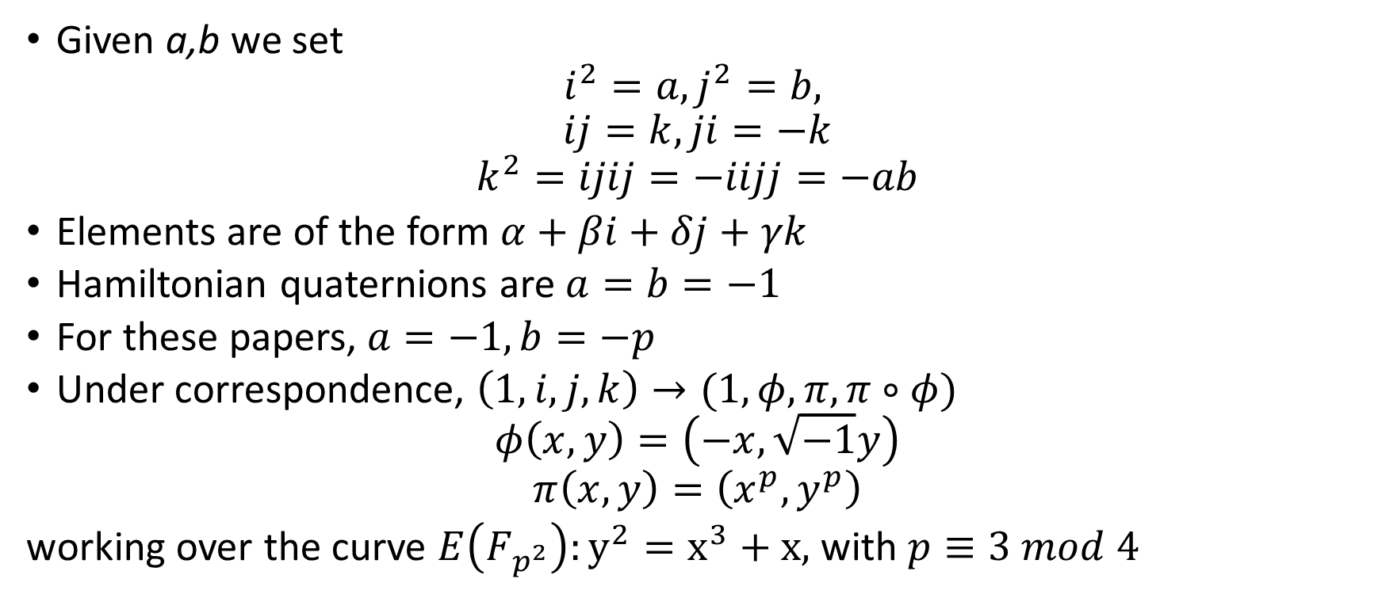
Quaternion Algebras
Given a,b we set
$$i^{2}=a, j^{2}=b,$$
$$ij=k, ji=−k$$
$$k^{2}=ijij=−iijj=−ab$$
Elements are of the form $α+βi+δj+γk$
Hamiltonian quaternions are $a=b=−1$
For these papers, $a=−1, b=−p$
Under correspondence, $\left(1,i,j,k\right)→(1,φ, π, π∘φ)$
$$φ\left(x,y\right)=\left(−x,\sqrt{−1}y\right)$$
$$π\left(x,y\right)=\left(x^{p},y^{p}\right)$$
working over the curve $E\left(F_{p^{2}}\right):y^{2}=x^{3}+x,$ with $p≡3 mod 4$
Notes:
Pi(pi(P))=(x^p^2,y^p^2). Elements have order p^2-1, so =(x,y).
Group is Z(p+1) x Z(p+1). -pP=P → pi^2=-p.

Slide 12
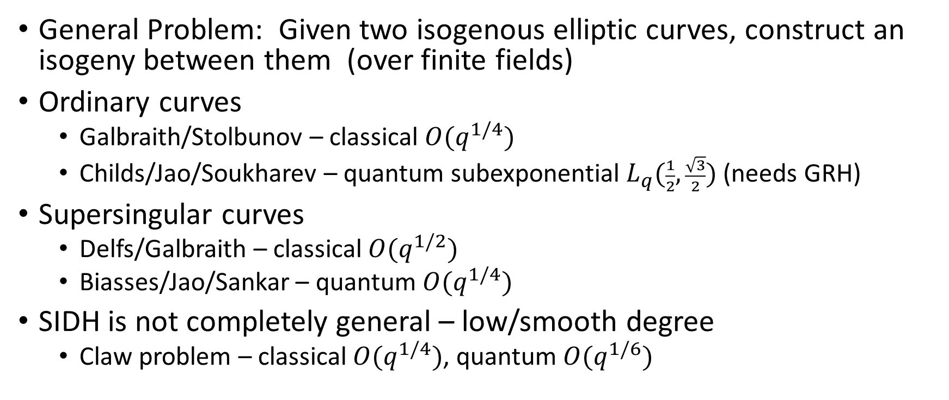
Security of isogeny-based crypto
General Problem: Given two isogenous elliptic curves, construct an isogeny between them (over finite fields)
Ordinary curves
  Galbraith/Stolbunov – classical $O(q^{1/4})$
  Childs/Jao/Soukharev – quantum subexponential $L_{q}(\frac{1}{2},\frac{\sqrt{3}}{2})$ (needs GRH)
Supersingular curves
  Delfs/Galbraith – classical $O(q^{1/2})$
  Biasses/Jao/Sankar – quantum $O(q^{1/4})$
SIDH is not completely general – low/smooth degree
  Claw problem – classical $O(q^{1/4})$, quantum $O(q^{1/6})$
Notes:
Claw Problem: For given two functions, f and g, the goal of the problem is to find x and y such that f(x)=g(y).

Slide 13
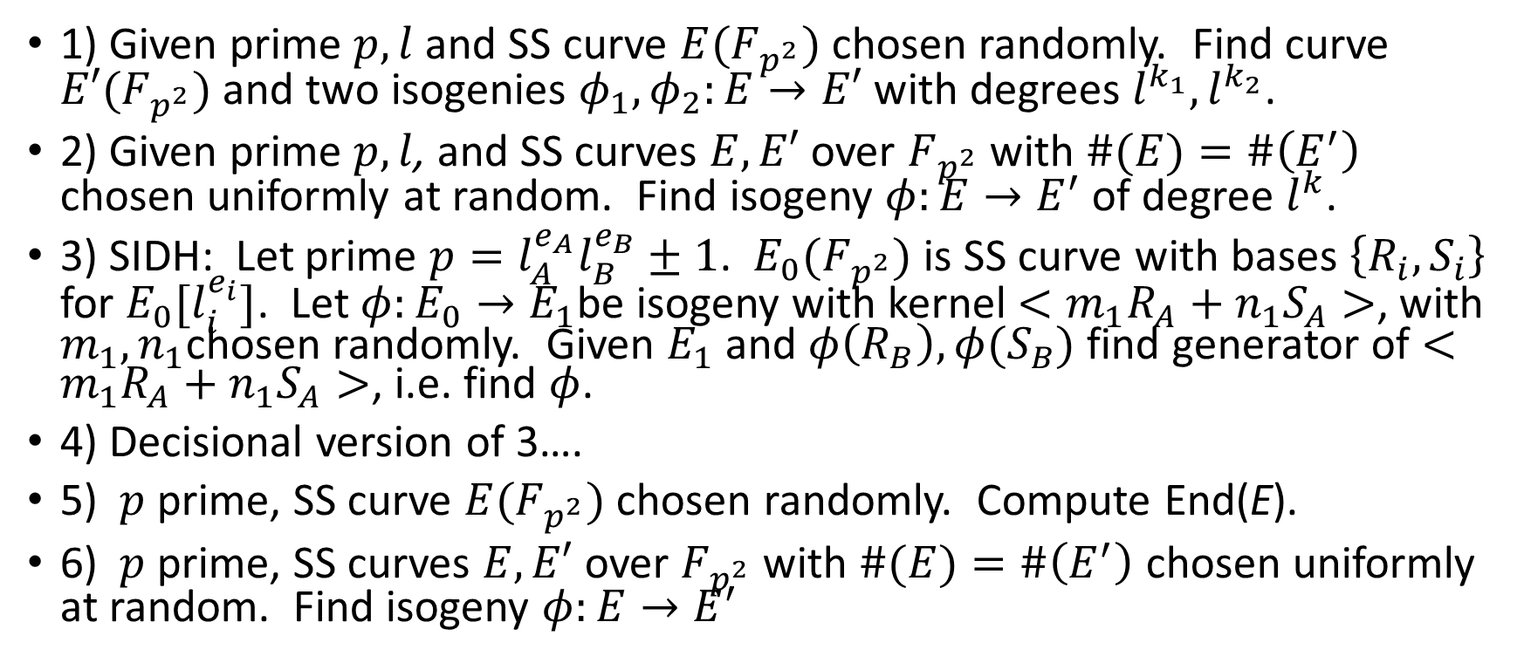
Isogeny Problems
1) Given prime $p,l$ and SS curve $E(F_{p^{2}})$ chosen randomly. Find curve $E′(F_{p^{2}})$ and two isogenies $φ_{1},φ_{2}:E→E′$ with degrees $l^{k_{1}},l^{k_{2}}$.
2) Given prime $p,l$, and SS curves $E,E′$ over $F_{p^{2}}$ with $\#(E)=\#\left(E^{′}\right)$ chosen uniformly at random. Find isogeny $φ:E→E^{′}$of degree $l^{k}$.
3) SIDH: Let prime $p=l_{A}^{e_{A}}l_{B}^{e_{B}}±1$. $E_{0}(F_{p^{2}})$ is SS curve with bases $\left\{R_{i},S_{i}\right\}$ for $E_{0}[l_{i}^{e_{i}}]$. Let $φ:E_{0}→E_{1}$be isogeny with kernel $<m_{1}R_{A}+n_{1}S_{A}>$, with $m_{1},n_{1}$chosen randomly. Given $E_{1}$ and $φ\left(R_{B}\right),φ(S_{B})$ find generator of $<m_{1}R_{A}+n_{1}S_{A}>$, i.e. find $φ$.
4) Decisional version of 3….
5) $p$ prime, SS curve $E(F_{p^{2}})$ chosen randomly. Compute End(E).
6) $p$ prime, SS curves $E,E′$ over $F_{p^{2}}$ with $\#(E)=\#\left(E^{′}\right)$ chosen uniformly at random. Find isogeny $φ:E→E^{′}$
Notes:
Was basis for hash function
Slight variation of 2) Basis for SIDH schemes
3) And 4) are actual basis for SIDH
3 and 4) are weaker than 1) and 2) because extra info is given, special prime form, and small degree isogenies exist.
5,6 more general. If can solve 2 or 6, can solve 5. Set E0=E1 and find isogenies = endomorphisms. Easy to find independent ones, which form a low index subring.
Heuristically the converse is true (use isogeny – ideal correspondence of Deuring)
5 is basis for Galbraith’s signature scheme

Slide 14
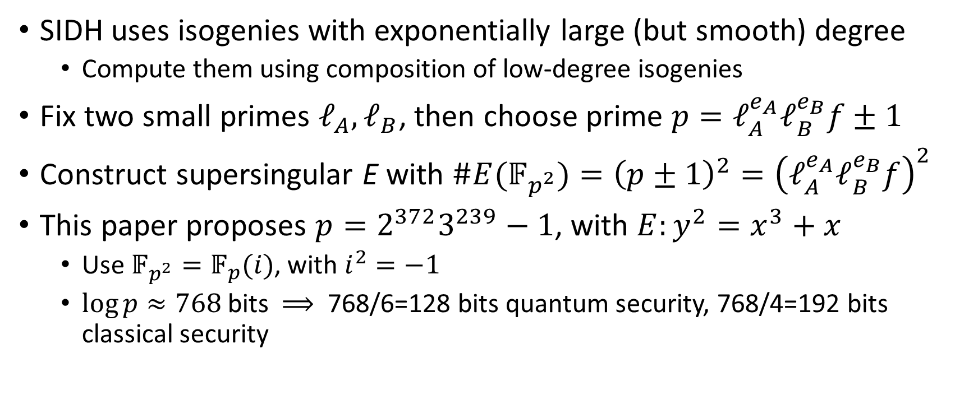
Parameters for SIDH
(Costello, Longa, Naehrig)
SIDH uses isogenies with exponentially large (but smooth) degree
  Compute them using composition of low-degree isogenies
Fix two small primes $ℓ_{A},ℓ_{B}$, then choose prime $p=ℓ_{A}^{e_{A}}ℓ_{B}^{e_{B}}f±1$
Construct supersingular E with $\#E(𝔽_{p^{2}})={\left(p±1\right)}^{2}={\left(ℓ_{A}^{e_{A}}ℓ_{B}^{e_{B}}f\right)}^{2}$
This paper proposes $p=2^{372}3^{239}−1$, with $E:y^{2}=x^{3}+x$
  Use $𝔽_{p^{2}}=𝔽_{p}(i)$, with $i^{2}=−1$
  $\log{p≈768 }$bits $⟹$ 768/6=128 bits quantum security, 768/4=192 bits classical security

Slide 15
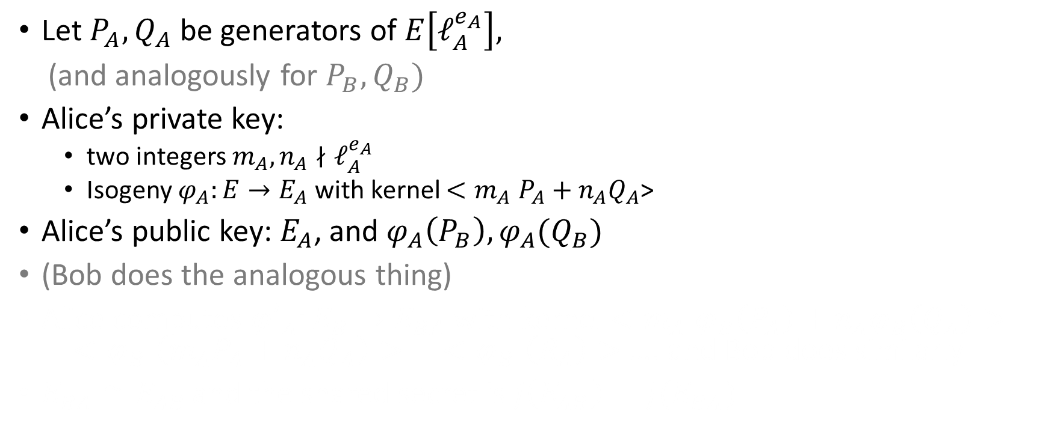
SIDH key-exchange
Let $P_{A},Q_{A}$ be generators of $E\left[ℓ_{A}^{e_{A}}\right],$
(and analogously for $P_{B},Q_{B})$
Alice’s private key:
  two integers $m_{A}, n_{A}∤ℓ_{A}^{e_{A}}$
  Isogeny $φ_{A}:E→E_{A}$ with kernel ${<m}_{A}P_{A}+n_{A}Q_{A}$>
Alice’s public key: $E_{A}$, and $φ_{A}\left(P_{B}\right),φ_{A}(Q_{B})$
(Bob does the analogous thing)
Alice computes ${φ′}_{A}:E_{B}→E_{BA}$ with kernel ${<m}_{A}φ_{B}\left(P_{A}\right)+n_{A}φ_{B}\left(Q_{A}\right)>{= <φ}_{B}\left(m_{A}P_{A}+n_{A}Q_{A}\right)> = {<φ}_{B}\left(R_{A}\right)>$ …. and Bob does similarly
$E_{BA}≅E_{AB }$and the shared secret is $j\left(E_{AB}\right)=j(E_{BA})$

Slide 16
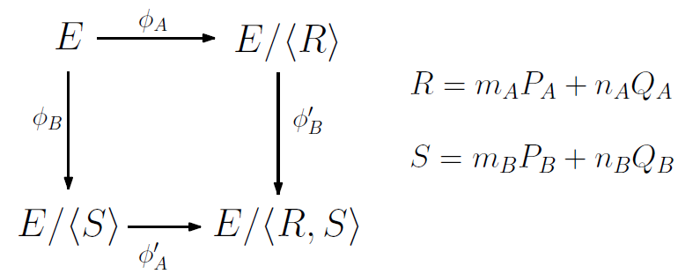
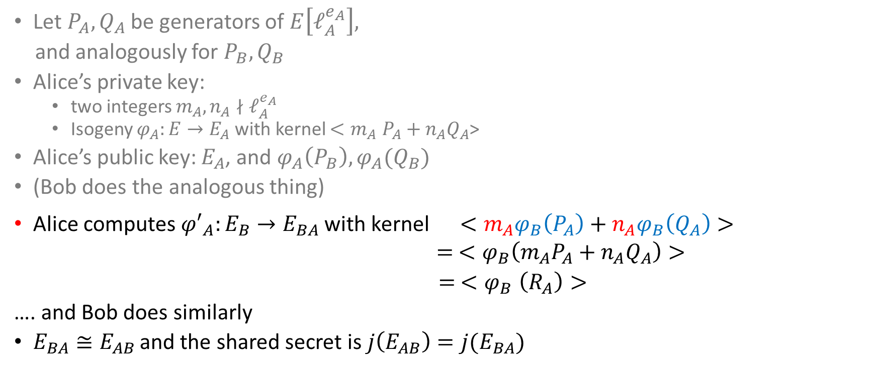
SIDH key-exchange
Let $P_{A},Q_{A}$ be generators of $E\left[ℓ_{A}^{e_{A}}\right],$
and analogously for $P_{B},Q_{B}$
Alice’s private key:
  two integers $m_{A}, n_{A}∤ℓ_{A}^{e_{A}}$
  Isogeny $φ_{A}:E→E_{A}$ with kernel ${<m}_{A}P_{A}+n_{A}Q_{A}$>
Alice’s public key: $E_{A}$, and $φ_{A}\left(P_{B}\right),φ_{A}(Q_{B})$
(Bob does the analogous thing)
Alice computes ${φ′}_{A}:E_{B}→E_{BA}$ with kernel ${ <m}_{A}φ_{B}\left(P_{A}\right)+n_{A}φ_{B}\left(Q_{A}\right)>{ = <φ}_{B}\left(m_{A}P_{A}+n_{A}Q_{A}\right)>$
$= {<φ}_{B}\left(R_{A}\right)>$
…. and Bob does similarly
$E_{BA}≅E_{AB }$and the shared secret is $j\left(E_{AB}\right)=j(E_{BA})$

Slide 17
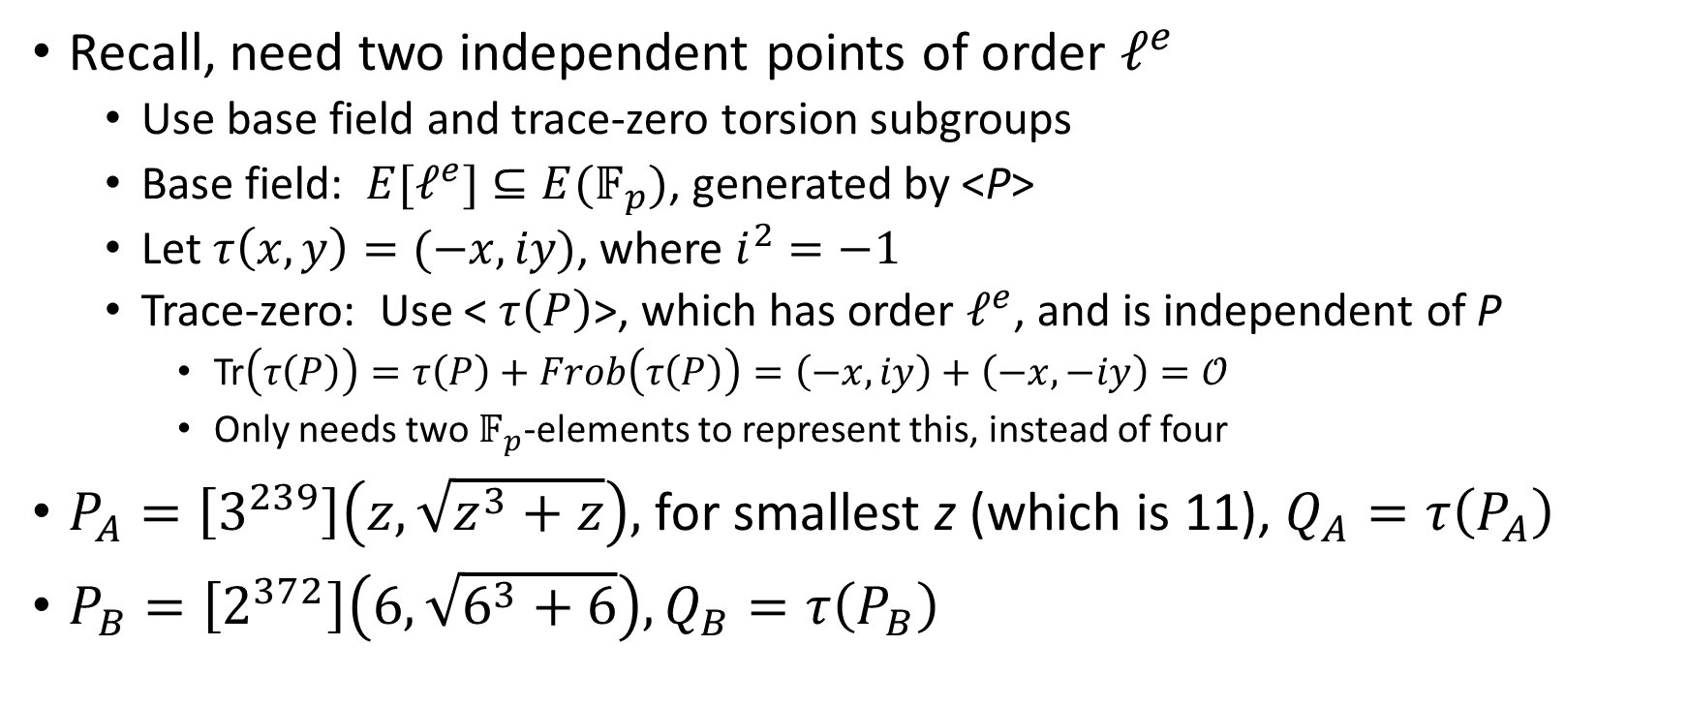
KeyGen details (1)
Recall, need two independent points of order $ℓ^{e}$
  Use base field and trace-zero torsion subgroups
  Base field: $E[ℓ^{e}]⊆E(𝔽_{p})$, generated by <P>
  Let $τ\left(x,y\right)=(−x,iy)$, where $i^{2}=−1$
  Trace-zero: Use < $τ\left(P\right)$>, which has order $ℓ^{e}$, and is independent of P
    Tr$\left(τ\left(P\right)\right)=τ\left(P\right)+Frob\left(τ\left(P\right)\right)=\left(−x,iy\right)+\left(−x,−iy\right)=𝒪$
    Only needs two $𝔽_{p}$-elements to represent this, instead of four
$P_{A}=\left[3^{239}\right]\left(z,\sqrt{z^{3}+z}\right),$for smallest z (which is 11), $Q_{A}=τ\left(P_{A}\right)$
$P_{B}=\left[2^{372}\right]\left(6,\sqrt{6^{3}+6}\right), Q_{B}=τ\left(P_{B}\right)$

Slide 18
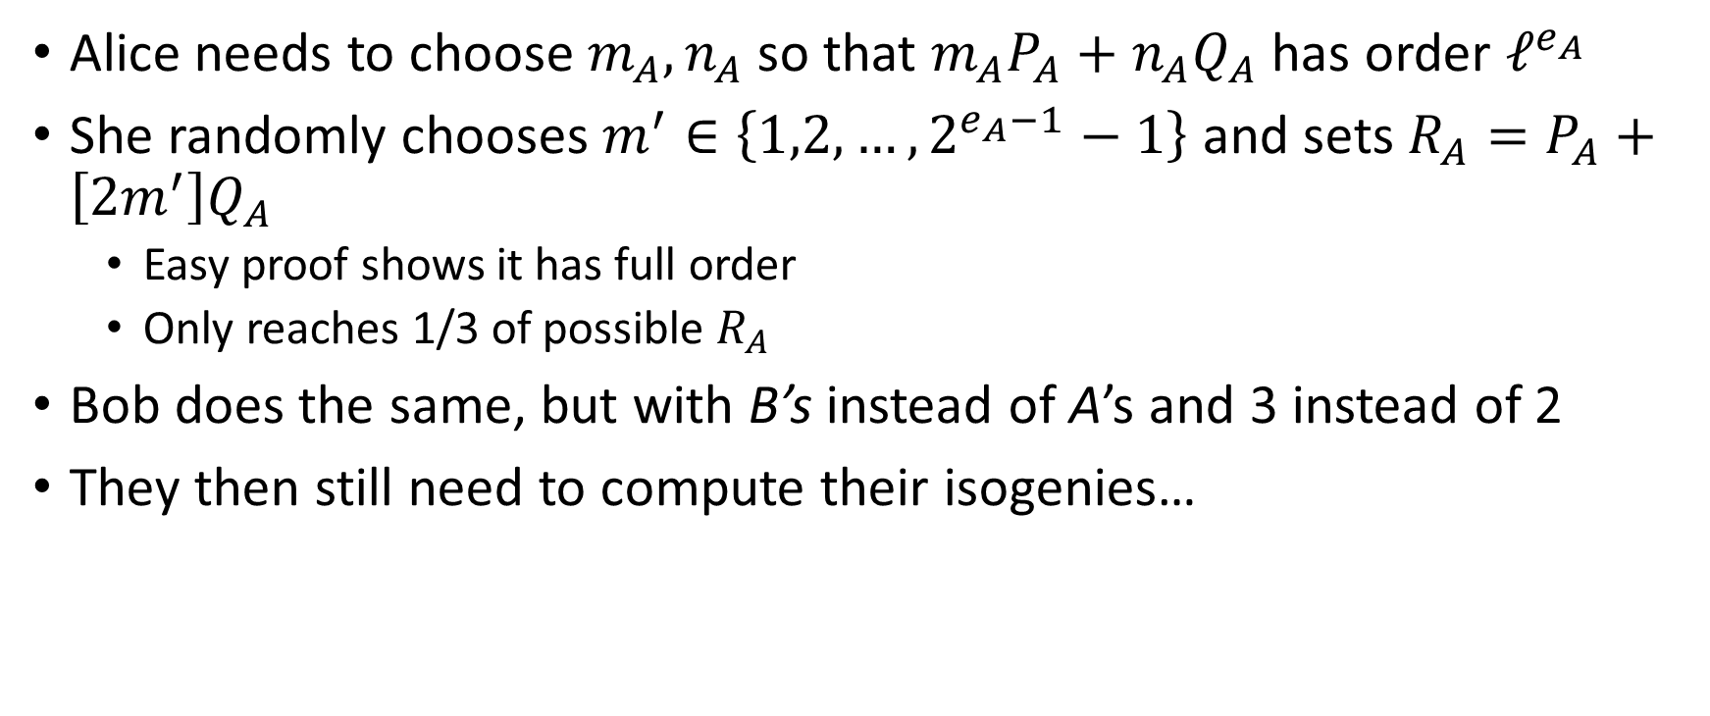
KeyGen details (2)
Alice needs to choose $m_{A},n_{A}$ so that $m_{A}P_{A}+n_{A}Q_{A}$has order $ℓ^{e_{A}}$
She randomly chooses $m^{′}∈\left\{1,2,…,2^{e_{A}−1}−1\right\}$ and sets $R_{A}=P_{A}+\left[2m^{′}\right]Q_{A}$
  Easy proof shows it has full order
  Only reaches 1/3 of possible $R_{A}$
Bob does the same, but with B’s instead of A’s and 3 instead of 2
They then still need to compute their isogenies…

Slide 19
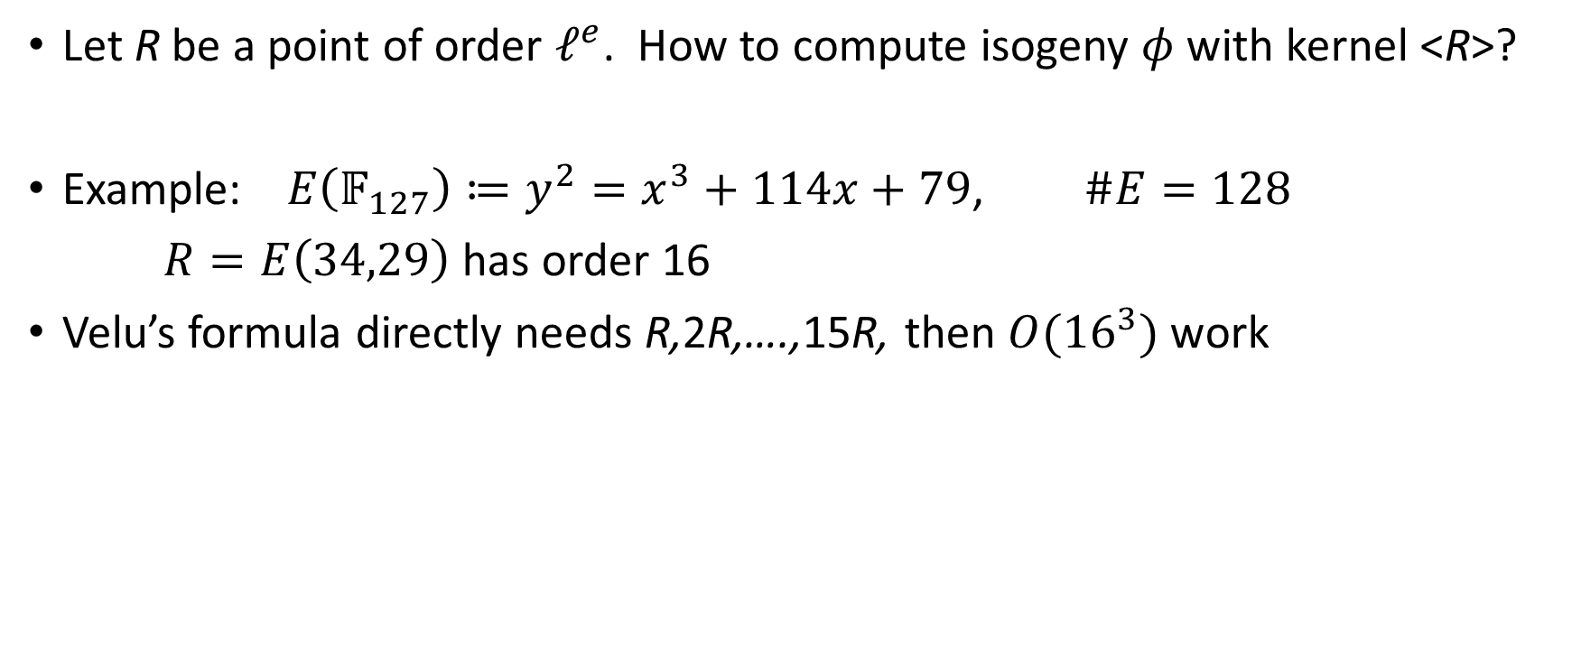
Computing the isogenies
Let R be a point of order $ℓ^{e}$. How to compute isogeny $φ$with kernel <R>?
Example: $E\left(𝔽_{127}\right)≔y^{2}=x^{3}+114x+79$, $\#E=128$
$R=E\left(34,29\right)$ has order 16
Velu’s formula directly needs R,2R,….,15R, then $O({16}^{3})$ work
Better: $φ_{R}=φ_{3}∘φ_{2}∘φ_{1}∘φ_{0}$, each $φ_{i}$ is of degree 2, $O(2^{3})$ work
2-isogeny: $(0,0)$ on $y^{2}=x^{3}+Ax^{2}+x$
$$\left(x,y\right)→(\frac{{\left(x−1\right)}^{2}}{x},y(1−\frac{1}{x^{2}}))$$
Notes:
Iterative way described is going to the right first, then going left.

Slide 20
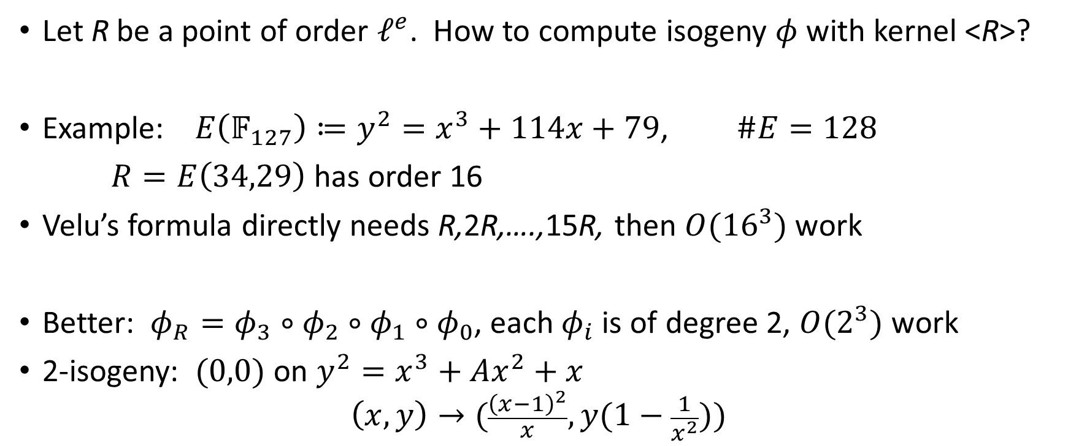
Computing the isogenies
Let R be a point of order $ℓ^{e}$. How to compute isogeny $φ$with kernel <R>?
Example: $E\left(𝔽_{127}\right)≔y^{2}=x^{3}+114x+79$, $\#E=128$
$R=E\left(34,29\right)$ has order 16
Velu’s formula directly needs R,2R,….,15R, then $O({16}^{3})$ work
Better: $φ_{R}=φ_{3}∘φ_{2}∘φ_{1}∘φ_{0}$, each $φ_{i}$ is of degree 2, $O(2^{3})$ work
2-isogeny: $(0,0)$ on $y^{2}=x^{3}+Ax^{2}+x$
$$\left(x,y\right)→(\frac{{\left(x−1\right)}^{2}}{x},y(1−\frac{1}{x^{2}}))$$

Slide 21









Example: 16-isogeny
$$R_{0}=R$$
For $φ_{0}$, need $8R$ (which has order 2)
$$[2]$$
$$φ_{0}$$
$$2R_{0}$$
$$[2]$$
$$4R_{0}$$
$$[2]$$
$$8R_{0}$$

Slide 22







Example: 16-isogeny
$$R_{0}=R$$
For $φ_{0}$, need $8R$ (which has order 2)
For $φ_{1}$, need $4R_{1}$ (which has order 2)
$$[2]$$
$$φ_{0}$$
$$2R_{0}$$
$$R_{1}=φ_{0}(R_{0})$$
$$[2]$$
$$[2]$$
$$φ_{1}$$
$$4R_{0}$$
$$2R_{1}$$
$$[2]$$
$$[2]$$
$$8R_{0}$$
$$4R_{1}$$

Slide 23





Example: 16-isogeny
$$R_{0}=R$$
For $φ_{0}$, need $8R$ (which has order 2)
For $φ_{1}$, need $4R_{1}$ (which has order 2)
For $φ_{2}$, need $2R_{2}$ (which has order 2)
$$[2]$$
$$φ_{0}$$
$$2R_{0}$$
$$R_{1}=φ_{0}(R_{0})$$
$$[2]$$
$$[2]$$
$$φ_{1}$$
$$4R_{0}$$
$$2R_{1}$$
$$R_{2}=φ_{1}(R_{1})$$
$$[2]$$
$$[2]$$
$$[2]$$
$$φ_{2}$$
$$8R_{0}$$
$$4R_{1}$$
$$2R_{2}$$

Slide 24



Example: 16-isogeny
$$R_{0}=R$$
For $φ_{0}$, need $8R$ (which has order 2)
For $φ_{1}$, need $4R_{1}$ (which has order 2)
For $φ_{2}$, need $2R_{2}$ (which has order 2)
For $φ_{3}$, need $R_{3}$ (which has order 2)
$$[2]$$
$$φ_{0}$$
$$2R_{0}$$
$$R_{1}=φ_{0}(R_{0})$$
$$[2]$$
$$[2]$$
$$φ_{1}$$
$$4R_{0}$$
$$2R_{1}$$
$$R_{2}=φ_{1}(R_{1})$$
$$[2]$$
$$[2]$$
$$[2]$$
$$φ_{2}$$
$$8R_{0}$$
$$4R_{1}$$
$$2R_{2}$$
$$R_{3}=φ_{2}(R_{2})$$
$$φ_{3}$$

Slide 25
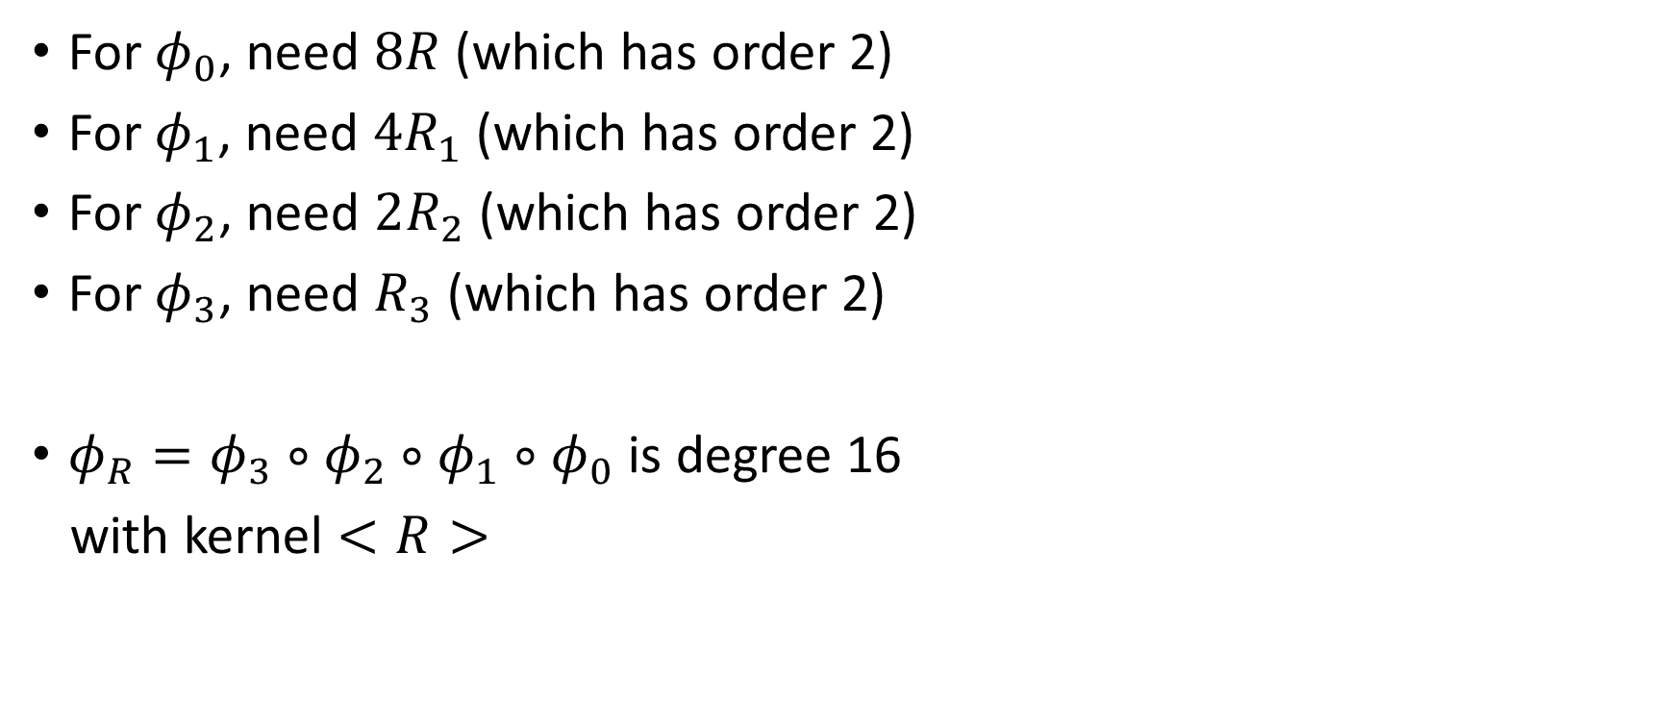
Example: 16-isogeny
$$R_{0}=R$$
For $φ_{0}$, need $8R$ (which has order 2)
For $φ_{1}$, need $4R_{1}$ (which has order 2)
For $φ_{2}$, need $2R_{2}$ (which has order 2)
For $φ_{3}$, need $R_{3}$ (which has order 2)
$φ_{R}=φ_{3}∘φ_{2}∘φ_{1}∘φ_{0}$ is degree 16
with kernel $<R>$
$$[2]$$
$$φ_{0}$$
$$2R_{0}$$
$$R_{1}=φ_{0}(R_{0})$$
$$[2]$$
$$[2]$$
$$φ_{1}$$
$$4R_{0}$$
$$2R_{1}$$
$$R_{2}=φ_{1}(R_{1})$$
$$[2]$$
$$[2]$$
$$[2]$$
$$φ_{2}$$
$$8R_{0}$$
$$4R_{1}$$
$$2R_{2}$$
$$R_{3}=φ_{2}(R_{2})$$
$$φ_{3}$$

Slide 26
Example: 16-isogeny – isogeny variant
$$R_{0}=R$$
For $φ_{0}$, need $8R$ (which has order 2)
$$[2]$$
$$φ_{0}$$
$$2R_{0}$$
$$[2]$$
$$4R_{0}$$
$$[2]$$
$$8R_{0}$$

Slide 27




Example: 16-isogeny – isogeny variant
$$R_{0}=R$$
For $φ_{0}$, need $8R$ (which has order 2)
For $φ_{1}$, need $4R_{1}$ (which has order 2)
$$[2]$$
$$φ_{0}$$
$$2R_{0}$$
$$R_{1}=φ_{0}(R_{0})$$
$$[2]$$
$$φ_{1}$$
$$4R_{0}$$
$$[2]$$
$$φ_{0}$$
$$8R_{0}$$
$$4R_{1}$$

Slide 28


Example: 16-isogeny – isogeny variant
$$R_{0}=R$$
For $φ_{0}$, need $8R$ (which has order 2)
For $φ_{1}$, need $4R_{1}$ (which has order 2)
$$[2]$$
$$φ_{0}$$
$$2R_{0}$$
$$R_{1}=φ_{0}(R_{0})$$
$$[2]$$
$$[2]$$
$$φ_{1}$$
$$4R_{0}$$
$$[2]$$
$$[2]$$
$$φ_{0}$$
$$8R_{0}$$
$$4R_{1}$$

Slide 29
Example: 16-isogeny – isogeny variant
$$R_{0}=R$$
For $φ_{0}$, need $8R$ (which has order 2)
For $φ_{1}$, need $4R_{1}$ (which has order 2)
$$[2]$$
$$φ_{0}$$
$$2R_{0}$$
$$R_{1}=φ_{0}(R_{0})$$
$$[2]$$
$$φ_{1}$$
$$4R_{0}$$
$$[2]$$
$$φ_{0}$$
$$8R_{0}$$
$$4R_{1}$$

Slide 30





Example: 16-isogeny – isogeny variant
$$R_{0}=R$$
For $φ_{0}$, need $8R$ (which has order 2)
For $φ_{1}$, need $4R_{1}$ (which has order 2)
For $φ_{2}$, need $2R_{2}$ (which has order 2)
$$[2]$$
$$φ_{0}$$
$$2R_{0}$$
$$R_{1}=φ_{0}(R_{0})$$
$$[2]$$
$$φ_{0}$$
$$φ_{1}$$
$$4R_{0}$$
$$R_{2}=φ_{1}(R_{1})$$
$$φ_{1}$$
$$[2]$$
$$φ_{0}$$
$$φ_{2}$$
$$8R_{0}$$
$$4R_{1}$$
$$2R_{2}$$

Slide 31


Example: 16-isogeny – isogeny variant
$$R_{0}=R$$
For $φ_{0}$, need $8R$ (which has order 2)
For $φ_{1}$, need $4R_{1}$ (which has order 2)
For $φ_{2}$, need $2R_{2}$ (which has order 2)
For $φ_{3}$, need $R_{3}$ (which has order 2)
$φ_{R}=φ_{3}∘φ_{2}∘φ_{1}∘φ_{0}$ is degree 16
with kernel $<R>$
$$[2]$$
$$φ_{0}$$
$$2R_{0}$$
$$R_{1}=φ_{0}(R_{0})$$
$$[2]$$
$$φ_{0}$$
$$φ_{1}$$
$$4R_{0}$$
$$R_{2}=φ_{1}(R_{1})$$
$$φ_{1}$$
$$[2]$$
$$φ_{0}$$
$$φ_{2}$$
$$8R_{0}$$
$$4R_{1}$$
$$2R_{2}$$
$$R_{3}=φ_{2}(R_{2})$$
$$φ_{3}$$

Slide 32
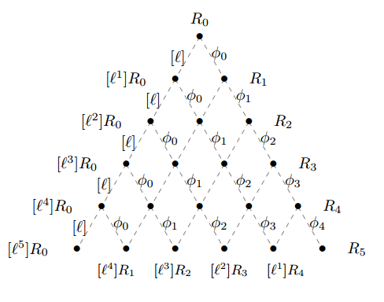

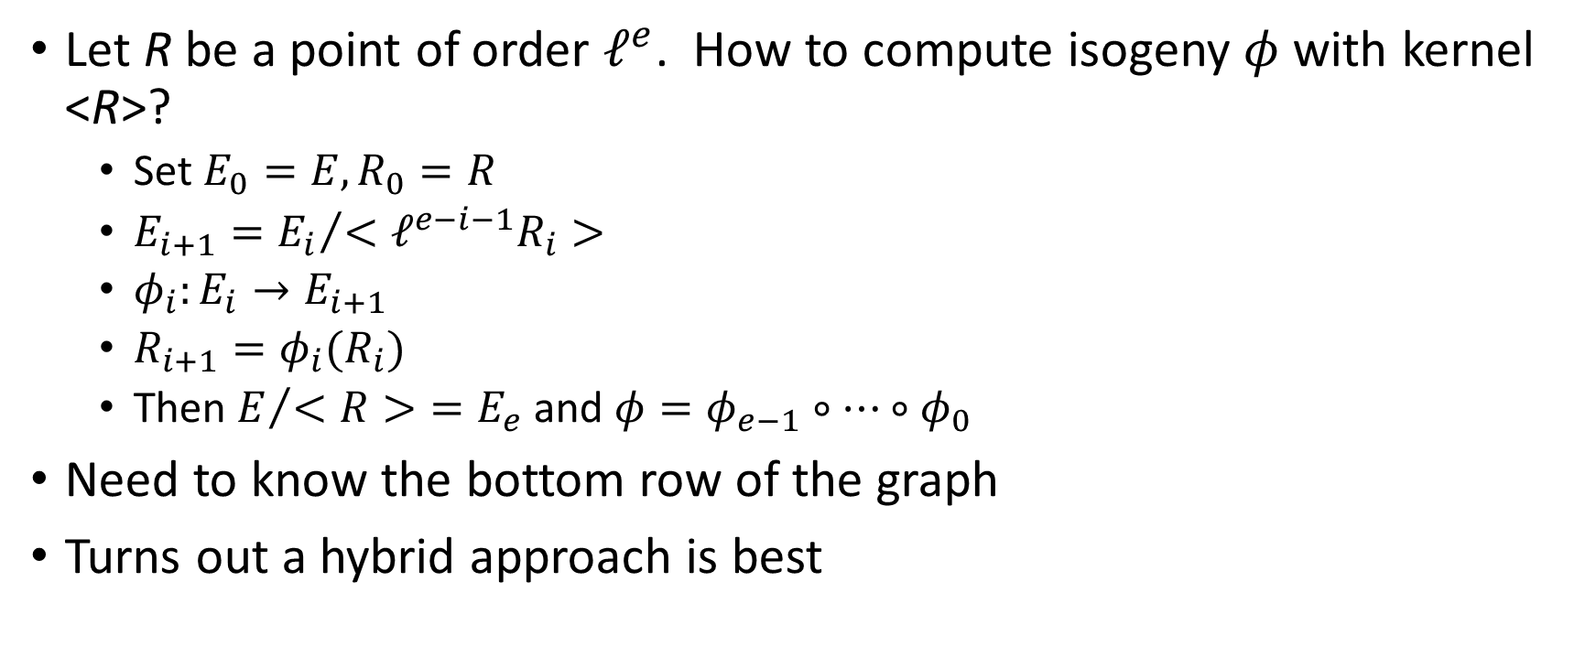
Computing the isogenies
Let R be a point of order $ℓ^{e}$. How to compute isogeny $φ$with kernel <R>?
  Set $E_{0}=E, R_{0}=R$
  $E_{i+1}={E_{i}}/{<ℓ^{e−i−1}R_{i}>}$
  $φ_{i}:E_{i}→E_{i+1}$
  $R_{i+1}=φ_{i}(R_{i})$
  Then $E/{<R>}=E_{e}$ and $φ=φ_{e−1}∘…∘φ_{0}$
Need to know the bottom row of the graph
Turns out a hybrid approach is best
Notes:
Iterative way described is going to the right first, then going left.
Don’t compute two ways to a point
Left/right are O(n^2), whereas middle is O(n log n)

Slide 33
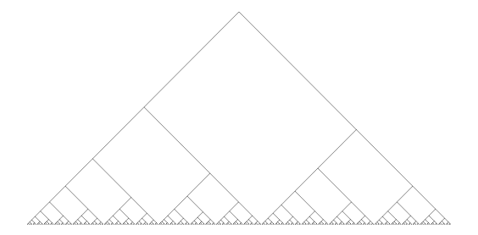
Optimal Strategy

Slide 34
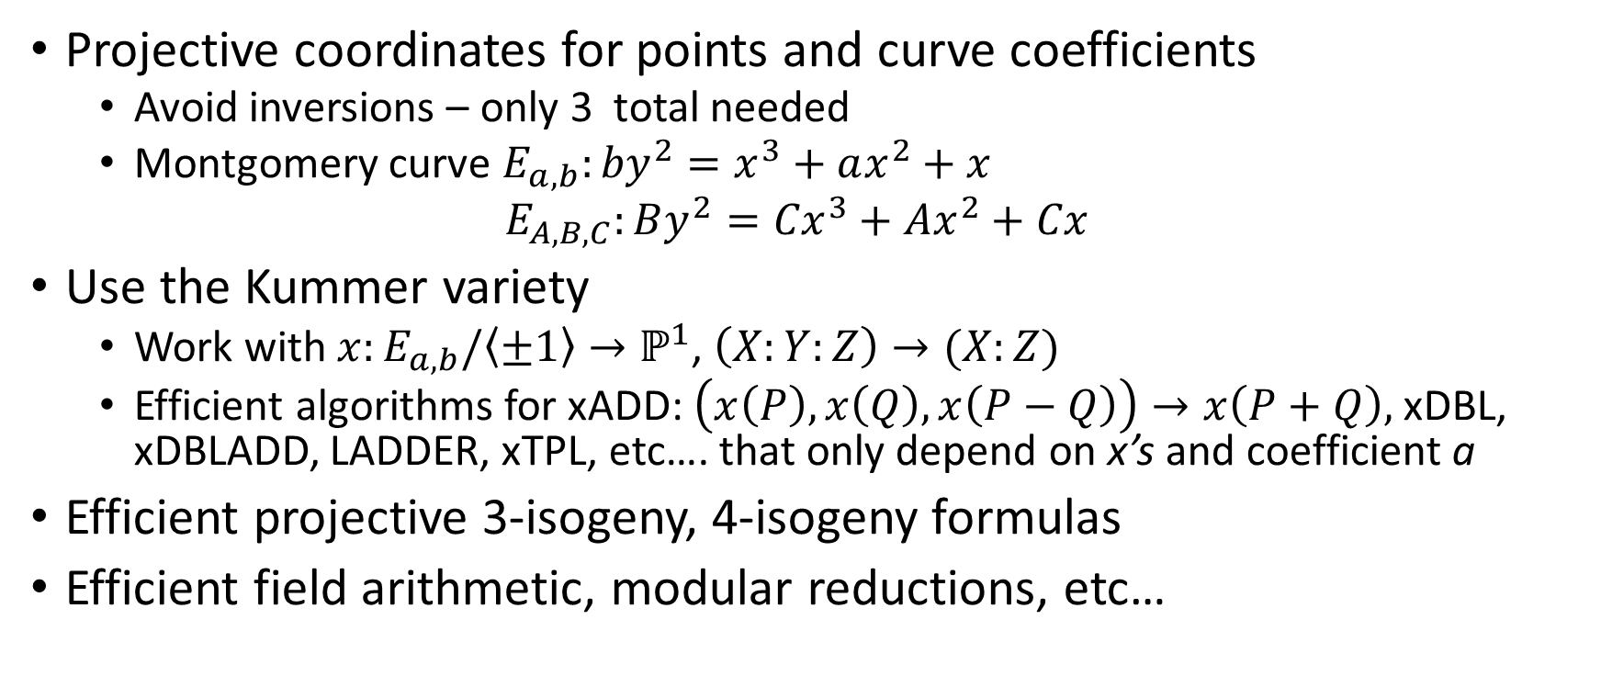
Technical improvements
Projective coordinates for points and curve coefficients
  Avoid inversions – only 3 total needed
  Montgomery curve ${E_{a,b}:by}^{2}=x^{3}+ax^{2}+x$
  $E_{A,B,C}:By^{2}={Cx}^{3}+Ax^{2}+Cx$
Use the Kummer variety
  Work with ${x:E}_{a,b}/\left\langle ±1\right\rangle →ℙ^{1}$, $\left(X:Y:Z\right)→(X:Z)$
  Efficient algorithms for xADD: $\left(x\left(P\right),x\left(Q\right),x\left(P−Q\right)\right)→x\left(P+Q\right),$xDBL, xDBLADD, LADDER, xTPL, etc…. that only depend on x’s and coefficient a
Efficient projective 3-isogeny, 4-isogeny formulas
Efficient field arithmetic, modular reductions, etc…

Slide 35
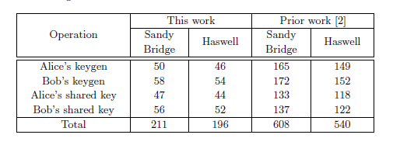
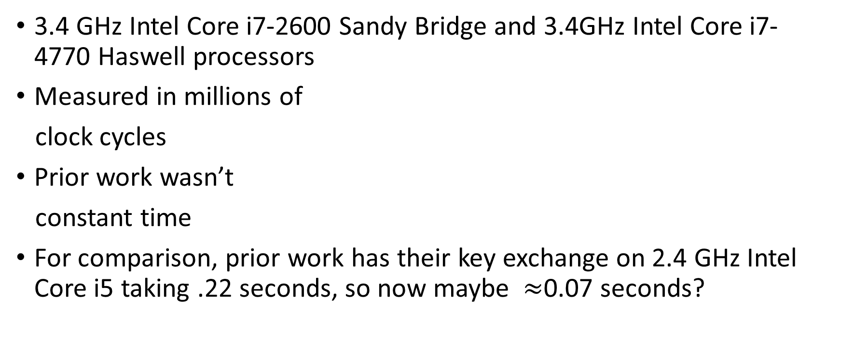
Performance
3.4 GHz Intel Core i7-2600 Sandy Bridge and 3.4GHz Intel Core i7-4770 Haswell processors
Measured in millions of
clock cycles
Prior work wasn’t
constant time
For comparison, prior work has their key exchange on 2.4 GHz Intel Core i5 taking .22 seconds, so now maybe $≈$0.07 seconds?
Notes:
Stolbunov’s – 229 s. Original SIDH was .4 seconds.

Slide 36
Comparison
Using Ebacs – roughly
DH Algorithm | KeyGen (cycles) | SharedSecret (cycles)
SIDH | 100,000,000 | 96,000,000
Curve 25519 | 172,000 | 163,000
Ed448 (Goldilocks) | 176,000 | 470,000
NIST P-256 | 246,000 | 600,000

Slide 37
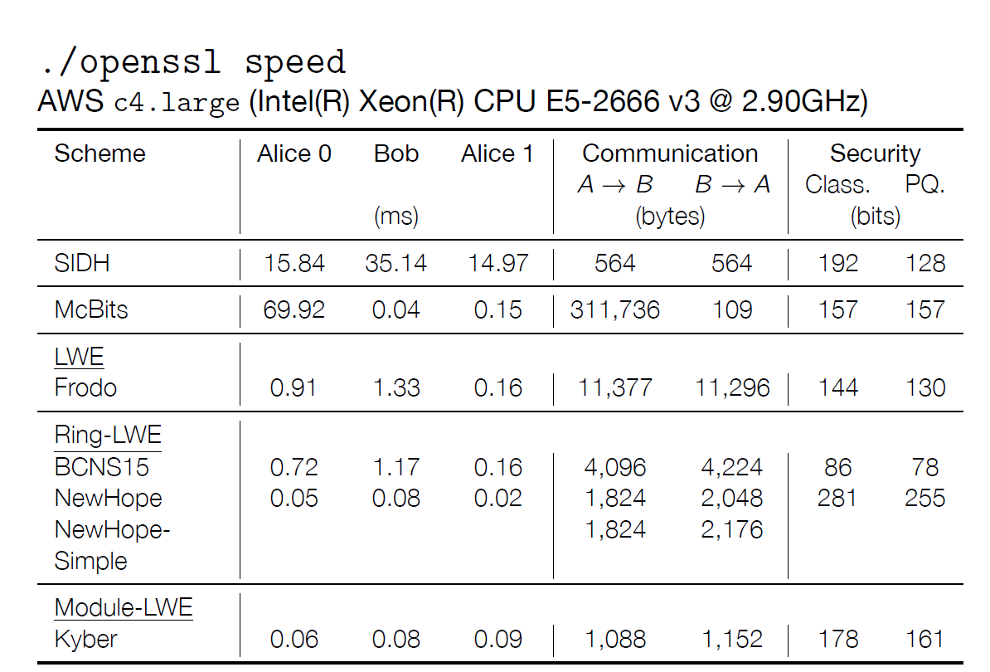
Comparison
Table is from Tancrede Lepoint, SRI International

Slide 38
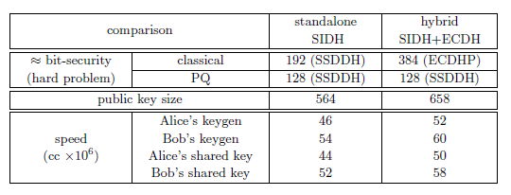
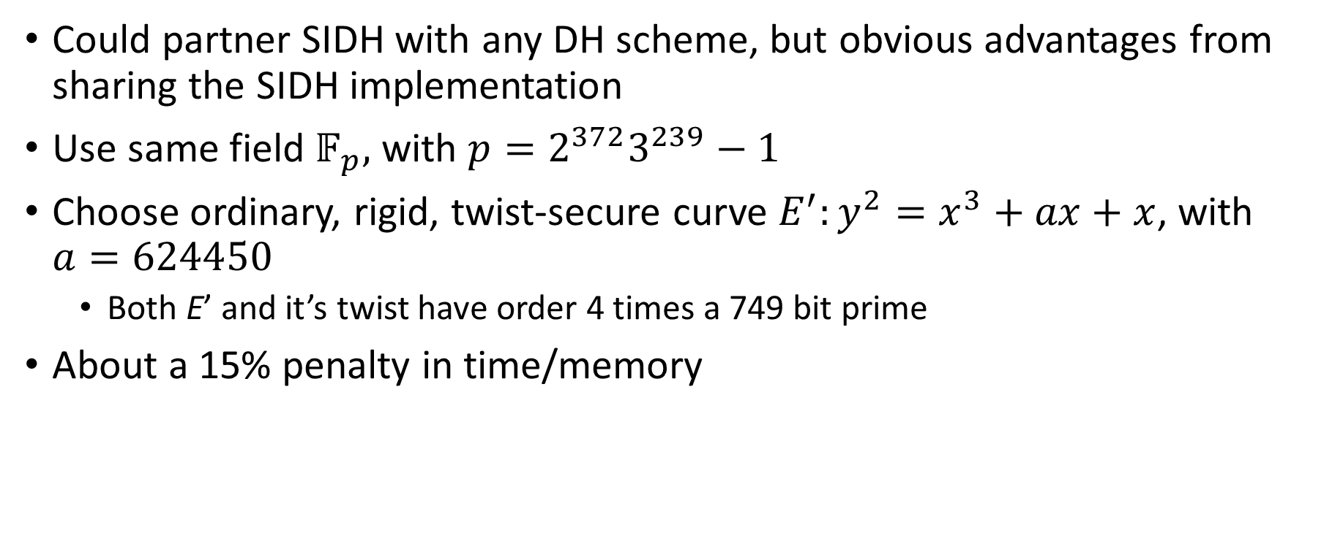
BigMont – SIDH+ECDH hybrid
Could partner SIDH with any DH scheme, but obvious advantages from sharing the SIDH implementation
Use same field $𝔽_{p},$ with $p=2^{372}3^{239}−1$
Choose ordinary, rigid, twist-secure curve ${E^{′}:y}^{2}=x^{3}+ax+x$, with $a=624450$
  Both E’ and it’s twist have order 4 times a 749 bit prime
About a 15% penalty in time/memory

Slide 39
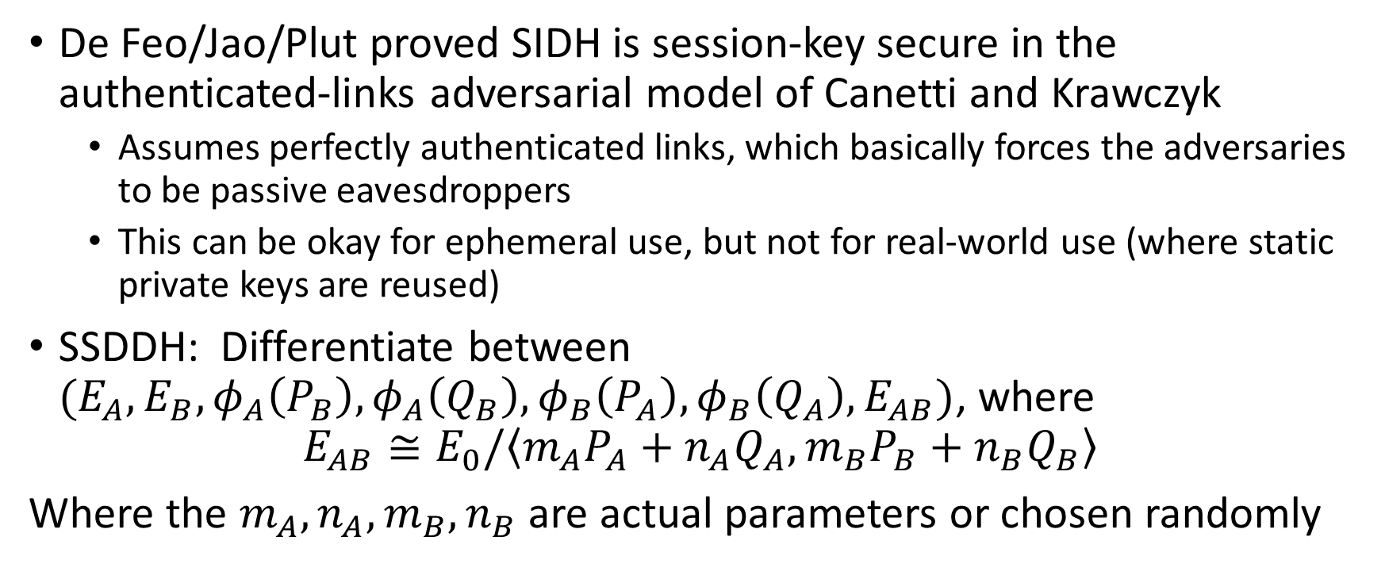
Security of SIDH
De Feo/Jao/Plut proved SIDH is session-key secure in the authenticated-links adversarial model of Canetti and Krawczyk
  Assumes perfectly authenticated links, which basically forces the adversaries to be passive eavesdroppers
  This can be okay for ephemeral use, but not for real-world use (where static private keys are reused)
SSDDH: Differentiate between $(E_{A},E_{B},φ_{A}\left(P_{B}\right), φ_{A}\left(Q_{B}\right), φ_{B}\left(P_{A}\right), φ_{B}\left(Q_{A}\right), E_{AB})$, where
$$E_{AB}≅E_{0}/\left\langle m_{A}P_{A}+n_{A}Q_{A},m_{B}P_{B}+n_{B}Q_{B}\right\rangle$$
Where the $m_{A},n_{A},m_{B},n_{B}$ are actual parameters or chosen randomly

Slide 40
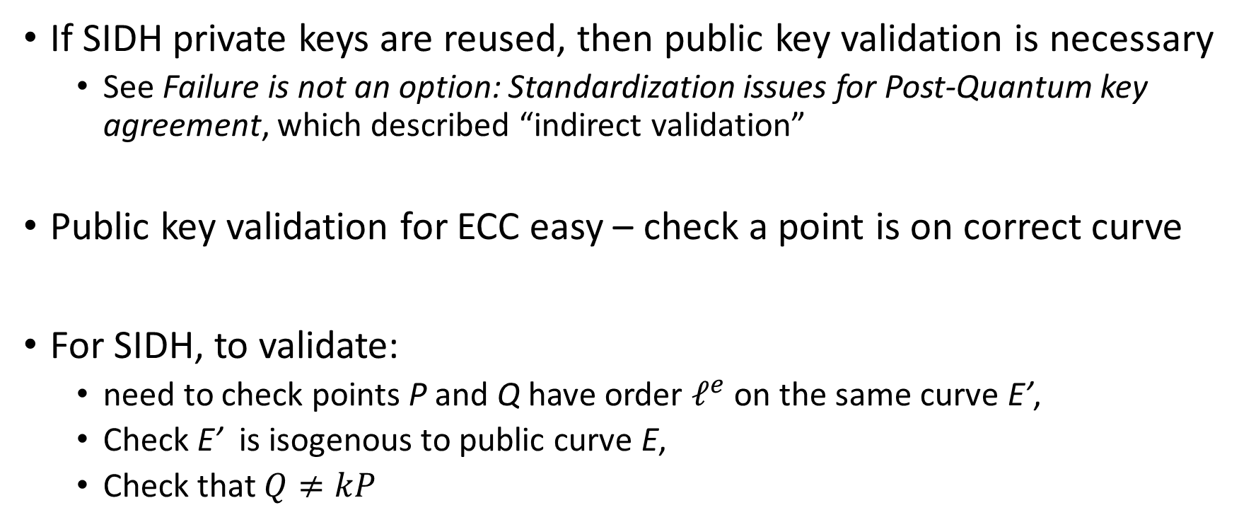
Public key validation
If SIDH private keys are reused, then public key validation is necessary
  See Failure is not an option: Standardization issues for Post-Quantum key agreement, which described “indirect validation”
Public key validation for ECC easy – check a point is on correct curve
For SIDH, to validate:
  need to check points P and Q have order $ℓ^{e}$ on the same curve E’,
  Check E’ is isogenous to public curve E,
  Check that $Q≠kP$

Slide 41
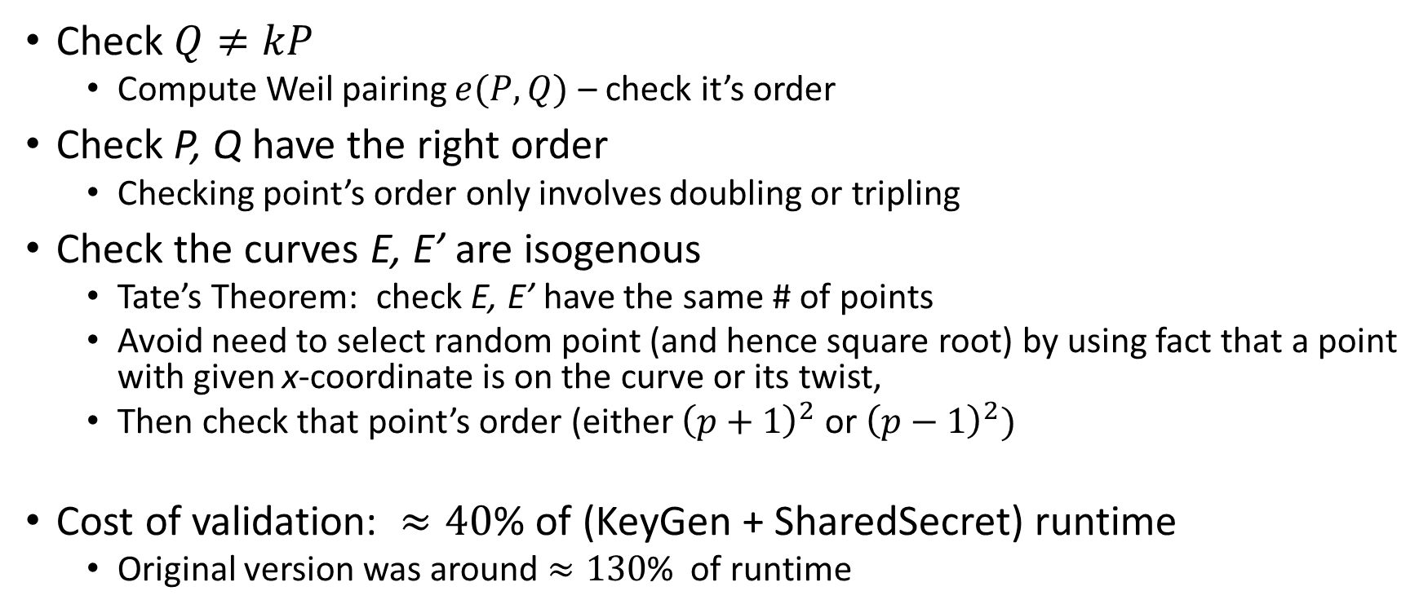
Public key validation -- Improved
Check $Q≠kP$
  Compute Weil pairing $e(P,Q)$ – check it’s order
Check P, Q have the right order
  Checking point’s order only involves doubling or tripling
Check the curves E, E’ are isogenous
  Tate’s Theorem: check E, E’ have the same # of points
  Avoid need to select random point (and hence square root) by using fact that a point with given x-coordinate is on the curve or its twist,
  Then check that point’s order (either ${\left(p+1\right)}^{2}$ or ${\left(p−1\right)}^{2})$
Cost of validation: $≈40$% of (KeyGen + SharedSecret) runtime
  Original version was around $≈130$% of runtime
Notes:
P+1 is the correct isogeny class

Slide 42
Summary of SIDH
State-of-the-art implementation of SIDH
  ~ 3 x faster than previous work, but is it fast enough?
  Constant time implementation
  Parameters for 128 bits of quantum security/192 bits classical security
  Public Key size: 4512 bits. Private Key size: 384 bits
ECDH+SIDH hybrid
  Adding ECDH only adds about 15% in time/memory
Public-key validation

Slide 43
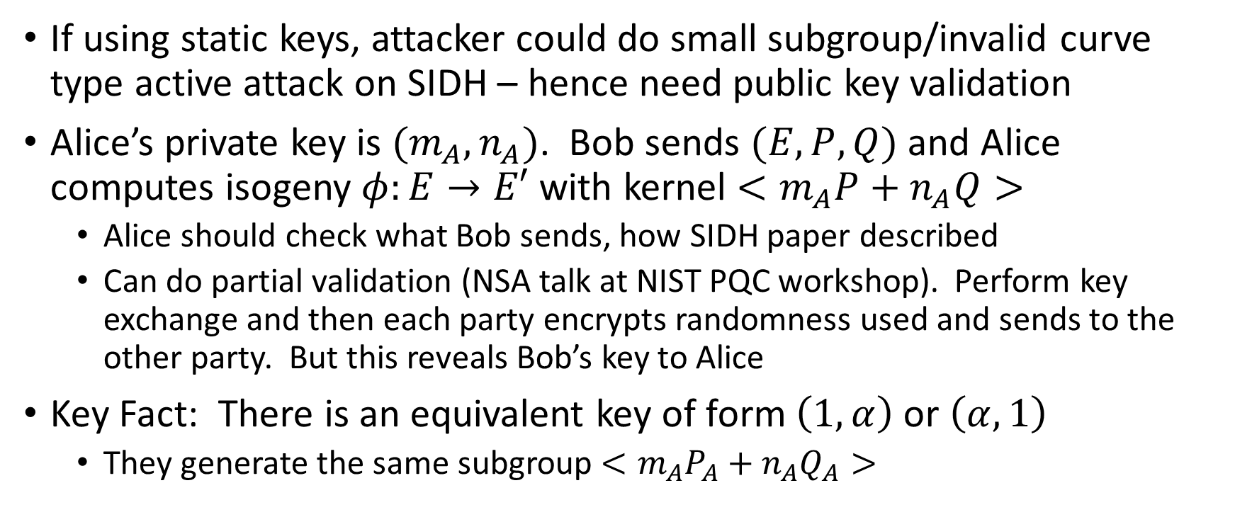
Active attack on static SIDH
(Galbraith, Petit, Shani, Ti)
If using static keys, attacker could do small subgroup/invalid curve type active attack on SIDH – hence need public key validation
Alice’s private key is $(m_{A},n_{A})$. Bob sends $(E,P,Q)$ and Alice computes isogeny $φ:E→E′$ with kernel $<m_{A}P+n_{A}Q>$
  Alice should check what Bob sends, how SIDH paper described
  Can do partial validation (NSA talk at NIST PQC workshop). Perform key exchange and then each party encrypts randomness used and sends to the other party. But this reveals Bob’s key to Alice
Key Fact: There is an equivalent key of form $\left(1,α\right)$ or $\left(α,1\right)$
  They generate the same subgroup $<m_{A}P_{A}+n_{A}Q_{A}>$
Notes:
Check E is SS, P,Q on E and have right order, and are independent.
This isn’t symmetric key exchange. Bob does several computations, computes session key, then sends to Alice.
If mA is odd, since working in group of order 2^n, it has an (odd) inverse theta. Then theta(mA,nA) is an equivalent generator, but it equals (theta mA,theta nA)=(1,alpha).

Slide 44
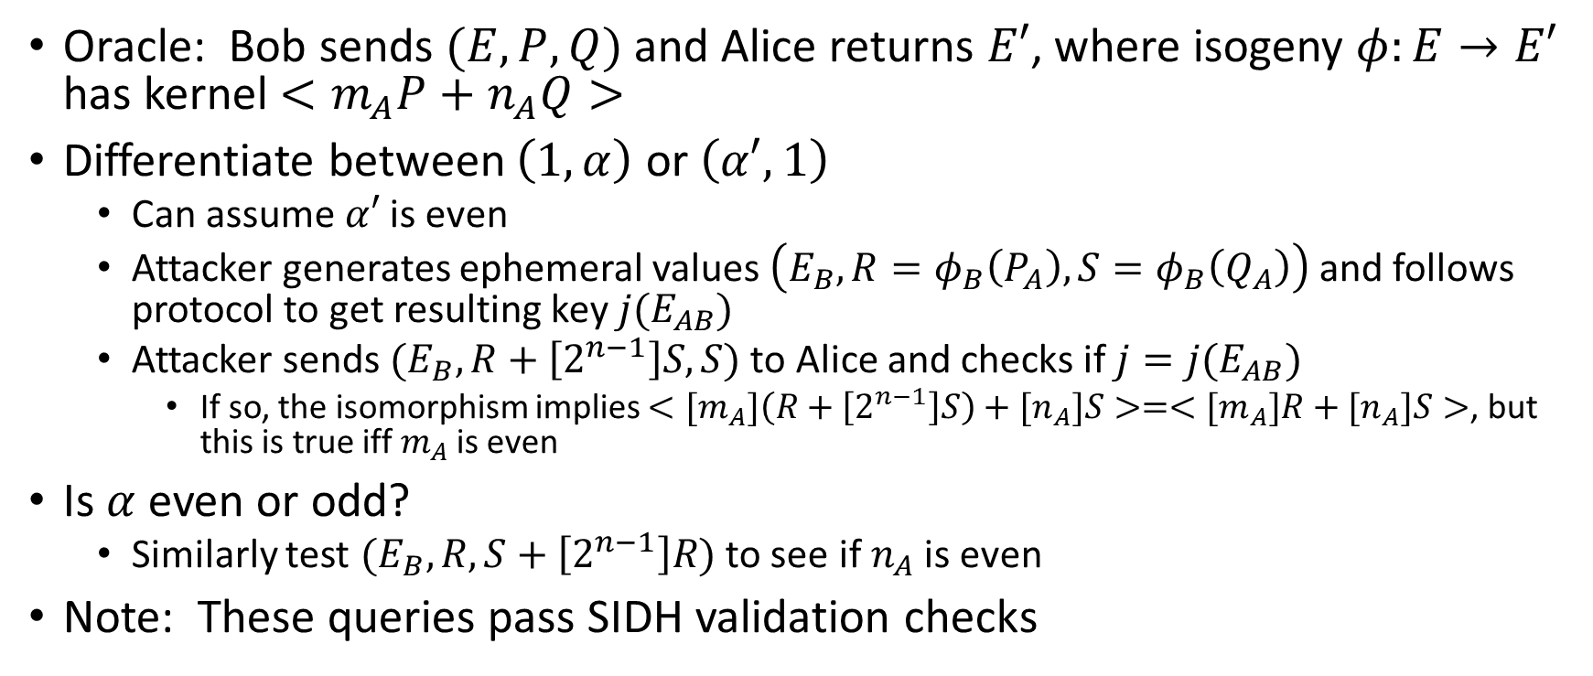
The attack – Step 1
Oracle: Bob sends $(E,P,Q)$ and Alice returns $E′$, where isogeny $φ:E→E′$ has kernel $<m_{A}P+n_{A}Q>$
Differentiate between $\left(1,α\right)$ or $\left(α′,1\right)$
  Can assume $α′$ is even
  Attacker generates ephemeral values $\left(E_{B},R=φ_{B}\left(P_{A}\right),S=φ_{B}\left(Q_{A}\right)\right)$ and follows protocol to get resulting key $j(E_{AB})$
  Attacker sends $(E_{B},R+\left[2^{n−1}\right]S,S)$ to Alice and checks if $j=j(E_{AB})$
    If so, the isomorphism implies $<{[m}_{A}]\left(R+\left[2^{n−1}\right]S\right)+{[n}_{A}]S>=<{[m}_{A}]R+{[n}_{A}]S>$, but this is true iff $m_{A}$ is even
Is $α$ even or odd?
  Similarly test $(E_{B},R,S+\left[2^{n−1}\right]R)$ to see if $n_{A}$ is even
Note: These queries pass SIDH validation checks
Notes:
Can be done with weaker oracle:
Oracle 2: Bob sends $(E,P,Q,E^{′})$ to Alice. Alice returns 1 if $j\left(E^{′}\right)=j(E/<m_{A}P+n_{A}Q>$)
For converse of iff: if subgroups are equal, then lambda * LeftPoint = RightPoint, for lambda in Z_2^n*. As R,S independent look at coeff of S to see lambda nA=nA, hence lambda=1. Then look at coeff of R. mA+nA2^n-1=mA, so nA2^n-1 = 0 mod 2^n as R has order 2^n, so nA even.

Slide 45
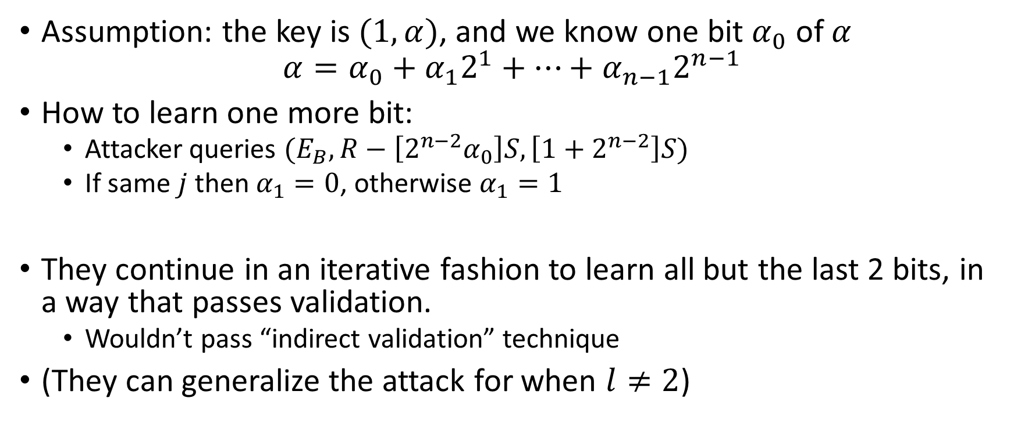
Continuing the attack
Assumption: the key is $(1,α)$, and we know one bit $α_{0}$ of $α$
$$α=α_{0}+α_{1}2^{1}+…+α_{n−1}2^{n−1}$$
How to learn one more bit:
  Attacker queries $(E_{B},R−\left[2^{n−2}α_{0}\right]S,\left[1+2^{n−2}\right]S)$
  If same $j$ then $α_{1}=0$, otherwise $α_{1}=1$
They continue in an iterative fashion to learn all but the last 2 bits, in a way that passes validation.
  Wouldn’t pass “indirect validation” technique
(They can generalize the attack for when $l≠2$)

Slide 46
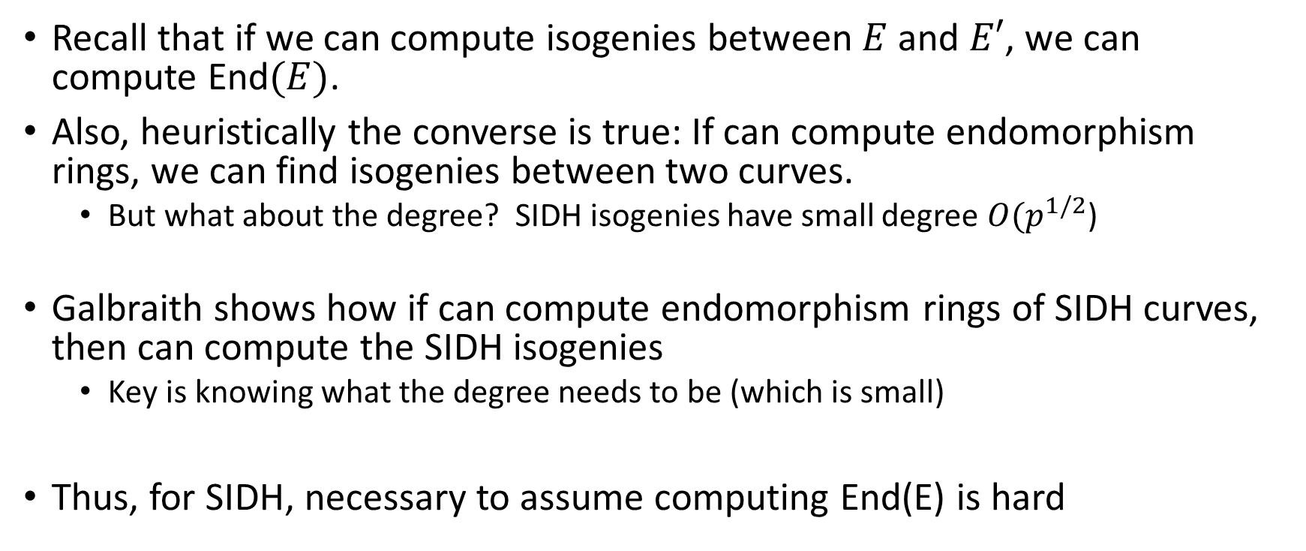
Computing endomorphism rings
Recall that if we can compute isogenies between $E$ and $E′$, we can compute End$(E)$.
Also, heuristically the converse is true: If can compute endomorphism rings, we can find isogenies between two curves.
  But what about the degree? SIDH isogenies have small degree $O(p^{1/2}$)
Galbraith shows how if can compute endomorphism rings of SIDH curves, then can compute the SIDH isogenies
  Key is knowing what the degree needs to be (which is small)
Thus, for SIDH, necessary to assume computing End(E) is hard

Slide 47
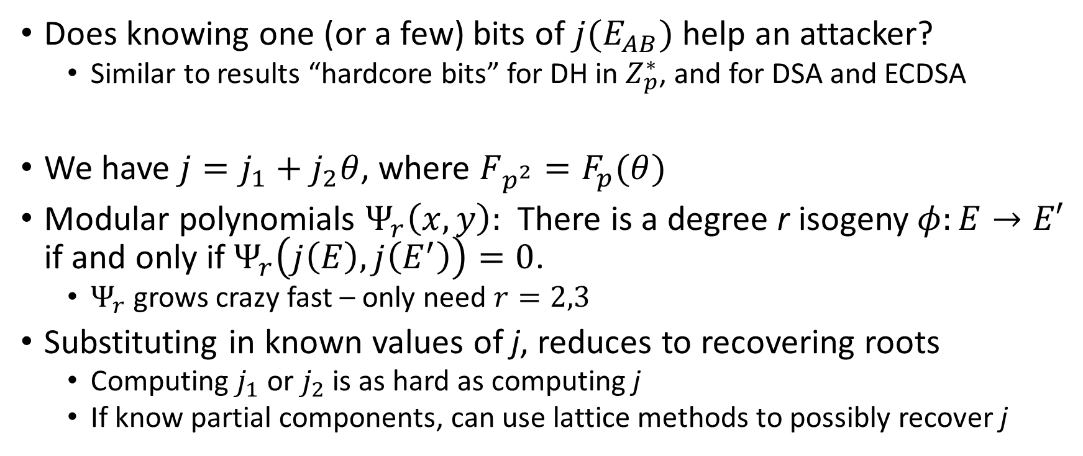

Bit security of $j(E_{AB})$
Does knowing one (or a few) bits of $j(E_{AB})$ help an attacker?
  Similar to results “hardcore bits” for DH in $Z_{p}^{∗}$, and for DSA and ECDSA
We have $j=j_{1}+j_{2}θ$, where $F_{p^{2}}=F_{p}(θ)$
Modular polynomials $Ψ_{r}\left(x,y\right):$ There is a degree r isogeny $φ:E→E′$ if and only if $Ψ_{r}\left(j\left(E\right),j\left(E^{′}\right)\right)=0$.
  $Ψ_{r}$ grows crazy fast – only need $r=2,3$
Substituting in known values of j, reduces to recovering roots
  Computing $j_{1}$ or $j_{2}$ is as hard as computing j
  If know partial components, can use lattice methods to possibly recover j

Slide 48
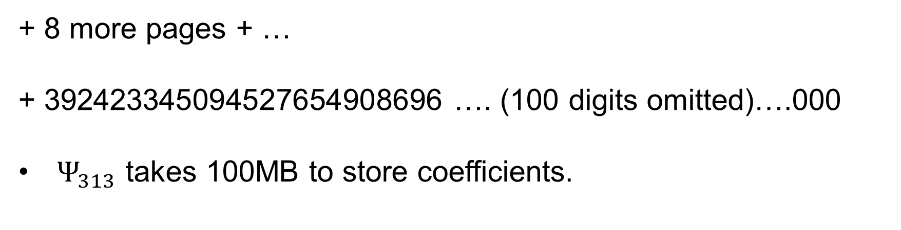

Modular Polynomials $Ψ_{r}(x,y)$
+ 8 more pages + …
+ 392423345094527654908696 …. (100 digits omitted)….000
$Ψ_{313}$ takes 100MB to store coefficients.
Notes:
Phi 11 is 2.6K
Phi 73 is 1M
Phi 313 is 100M

Slide 49
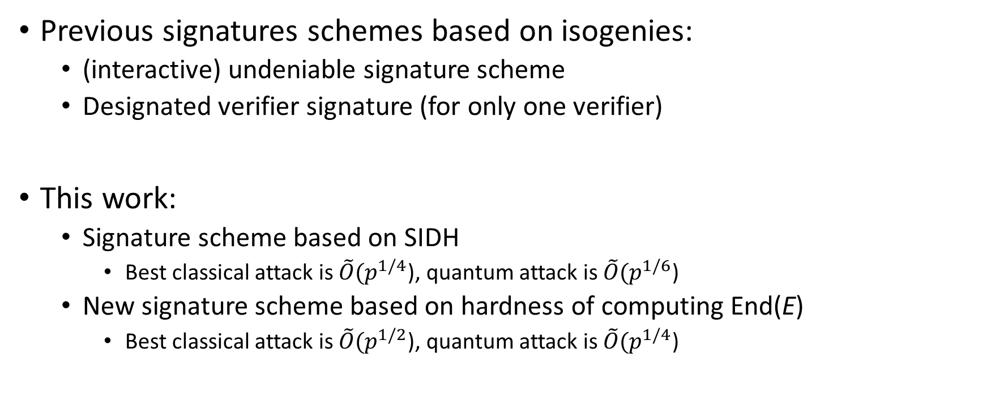
Supersingular Signatures
Galbraith, Petit, Silva
Previous signatures schemes based on isogenies:
  (interactive) undeniable signature scheme
  Designated verifier signature (for only one verifier)
This work:
  Signature scheme based on SIDH
    Best classical attack is $\tilde{O}(p^{1/4}$), quantum attack is $\tilde{O}(p^{1/6}$)
  New signature scheme based on hardness of computing End(E)
    Best classical attack is $\tilde{O}(p^{1/2}$), quantum attack is $\tilde{O}(p^{1/4}$)

Slide 50
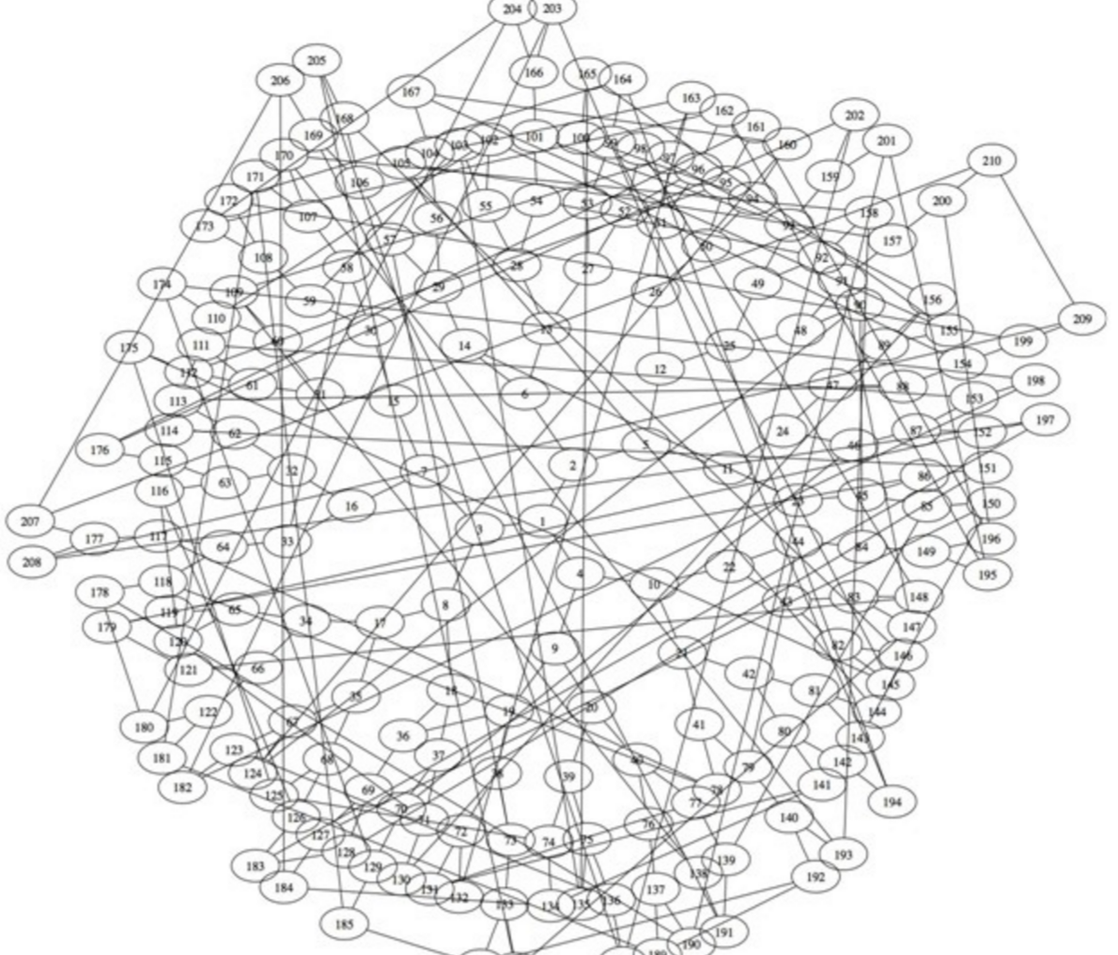
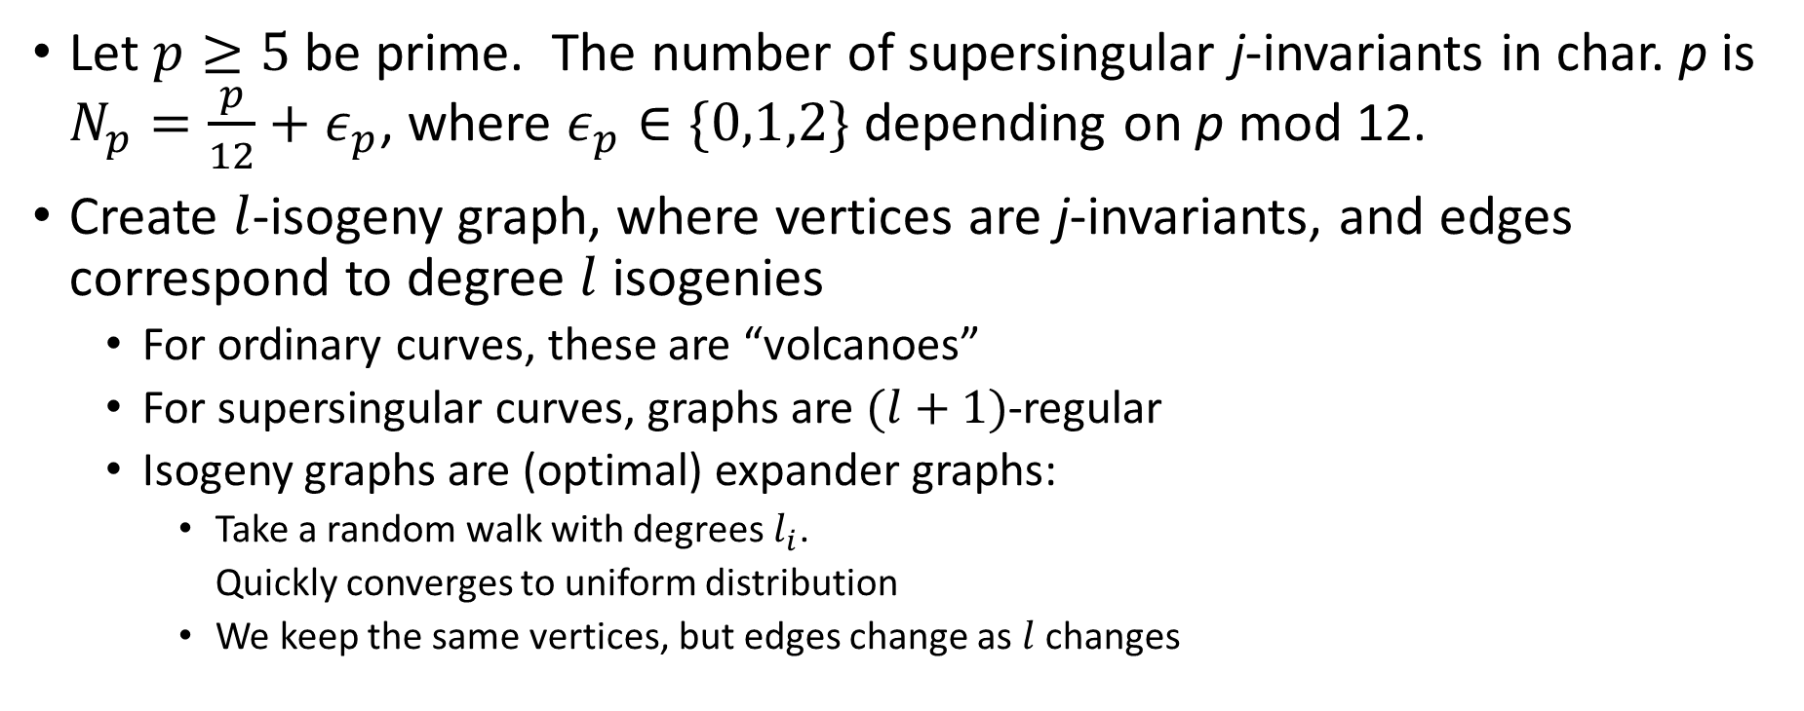
Random walks in isogeny graphs
Let $p≥5$ be prime. The number of supersingular j-invariants in char. p is $N_{p}=\frac{p}{12}+ε_{p}$, where $ε_{p}∈\{0,1,2\}$ depending on p mod 12.
Create $l$-isogeny graph, where vertices are j-invariants, and edges correspond to degree $l$ isogenies
  For ordinary curves, these are “volcanoes”
  For supersingular curves, graphs are $(l+1)$-regular
  Isogeny graphs are (optimal) expander graphs:
    Take a random walk with degrees $l_{i}$.
    Quickly converges to uniform distribution
    We keep the same vertices, but edges change as $l$ changes
Notes:
Bound between random j and uniform distribution is p^2/72, which leads to lambda = 2 log p.

Slide 51
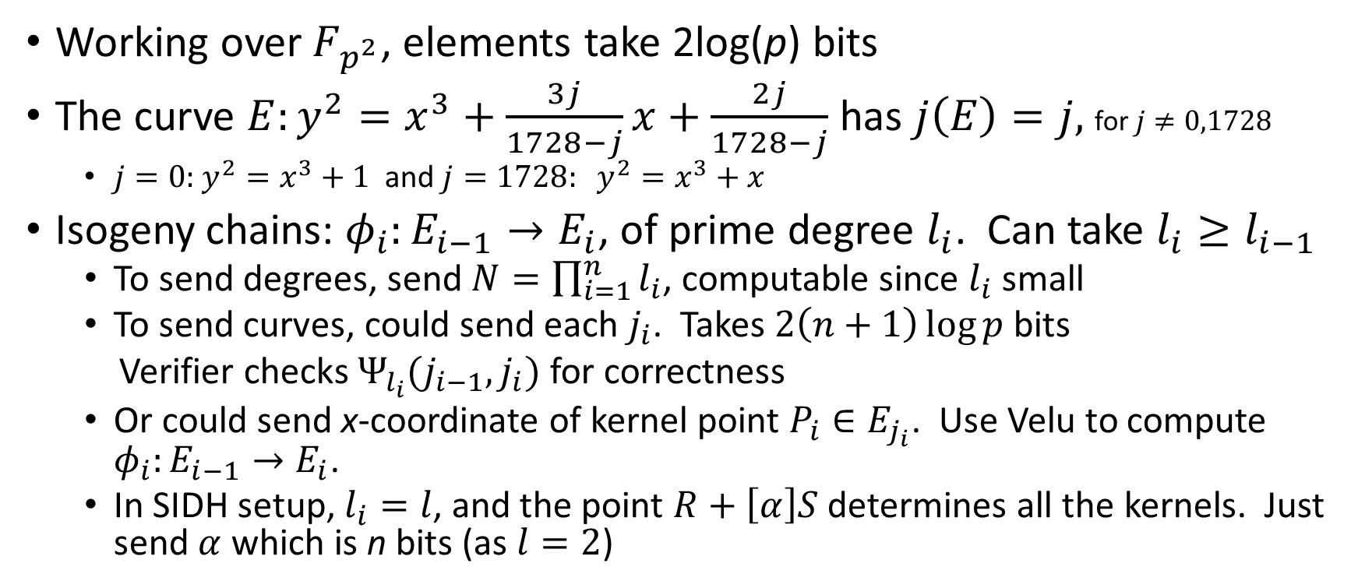
Representing isogenies efficiently
Working over $F_{p^{2}}$, elements take 2log(p) bits
The curve ${E:y}^{2}=x^{3}+\frac{3j}{1728−j}x+\frac{2j}{1728−j}$ has $j\left(E\right)=j,$ for $j≠0,1728$
  $j=0:$ $y^{2}=x^{3}+1$ and $j=1728: y^{2}=x^{3}+x$
Isogeny chains: $φ_{i}:E_{i−1}→E_{i}$, of prime degree $l_{i}$. Can take $l_{i}≥l_{i−1}$
  To send degrees, send $N=\prod_{i=1}^{n}{l_{i}}$, computable since $l_{i}$ small
  To send curves, could send each $j_{i}$. Takes $2\left(n+1\right)\log{p}$ bits
  Verifier checks $Ψ_{l_{i}}(j_{i−1},j_{i})$ for correctness
  Or could send x-coordinate of kernel point $P_{i}∈E_{j_{i}}$. Use Velu to compute $φ_{i}:E_{i−1}→E_{i}$.
  In SIDH setup, $l_{i}=l$, and the point $R+\left[α\right]S$ determines all the kernels. Just send $α$ which is n bits (as $l=2$)

Slide 52
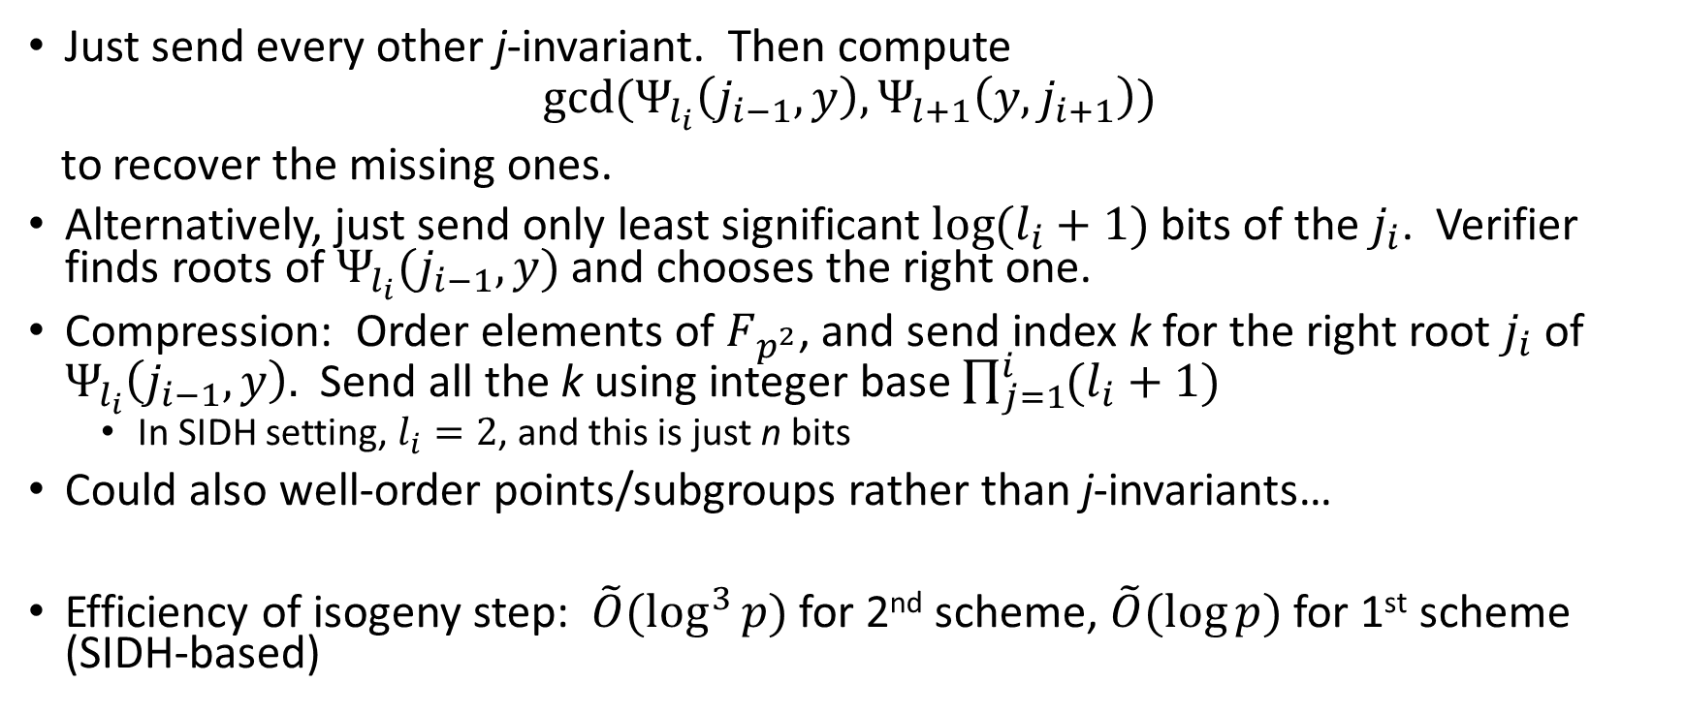
Optimizations for isogeny chains
Just send every other j-invariant. Then compute
$$\gcd{(Ψ_{l_{i}}\left(j_{i−1},y\right),Ψ_{l+1}\left(y,j_{i+1}\right))}$$
to recover the missing ones.
Alternatively, just send only least significant $\log{(l_{i}+1)}$bits of the $j_{i}$. Verifier finds roots of $Ψ_{l_{i}}(j_{i−1},y)$ and chooses the right one.
Compression: Order elements of $F_{p^{2}}$, and send index k for the right root $j_{i}$ of $Ψ_{l_{i}}\left(j_{i−1},y\right).$ Send all the k using integer base $\prod_{j=1}^{i}{(l_{i}+1)}$
  In SIDH setting, $l_{i}=2$, and this is just n bits
Could also well-order points/subgroups rather than j-invariants…
Efficiency of isogeny step: $\tilde{O}(\log^{3}{p) }$for 2nd scheme, $\tilde{O}(\log{p)}$for 1st scheme (SIDH-based)
Notes:
Compression seems optimal, since \prod (li+1) possible isogeny paths
For SIDH, each li=2 or 3. For other scheme li=O(log p)

Slide 53
Identification schemes
Interactive protocol between Prover and Verifier
  Correctness – If Prover knows secret, then Verifier will accept
  Soundness – If adversary doesn’t know secret, can’t convince Verifier
  Honest Verifier Zero-Knowledge – transcript of honest execution reveals no information
Graph Isomorphism Protocol
  Peggy knows graphs A and B are isomorphic. Wants to convince Victor.
  Peggy creates isomorphic graph H.
  Victor sends challenge bit. If 0, Peggy shows isomorphism to A. Else to B.
  Repeat n rounds

Slide 54
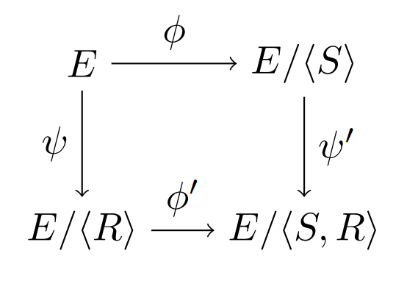

Isogeny-based ID scheme
Original de Feo/Jao/Plut SIDH paper had identification scheme
  Secret Key: SS curve E, with $l_{A}^{e_{A}}−$torsion point S defining isogeny $φ:E→E/<S>$
  Public: The curves $E,E/<S>$. Generators $P,Q$ of $E[l_{B}^{e_{B}}]$, and $φ\left(P\right),φ(Q)$
  ID protocol:
  1) Peggy chooses random $R=α_{1}P+α_{2}Q$ and computes diagram.
  Sends $E/\left\langle R\right\rangle$ and $E/\left\langle S,R\right\rangle$ to Victor.
  2) Victor sends random bit to Peggy
  3) If b=0, Peggy reveals $R$ and $φ′(R)$. Victor accepts if they
  have the right order and generate $ψ$ and $ψ′$
  4) If b=1, Peggy reveals $ψ(S)$. Victor accepts if it has the
  right order and that it generates $φ′$

Slide 55

From SIDH to Signatures
Fiat-Shamir transform makes signature schemes from ID schemes
  Idea: make interactive protocol non-interactive by using random oracle to produce the challenges
  Unruh transform – variant of Fiat-Shamir that provides security against quantum adversaries.
This work: Full specification of how to do this in a smart way
  Use optimizations on representing curves and isogeny chains
  Secure under chosen message attack in Random Oracle Model
Efficiency
  Secret key: $2\log{p}$ bits, Public Key: $13\log{p}$ bits ($log p≈4 λ$)
  Signature size: at least 6$λ^{2}$ bits
  Both signing/verifying are $\tilde{O}(λ^{3})$ bits, where $λ$ is security parameter

Slide 56


A new isogeny-based ID Scheme
Motivation: SIDH isogeny problem isn’t general
Let $E_{0}$ be curve with for which End$\left(E_{0}\right)$ can be computed
Take random isogeny (walk in the graph) $φ:E_{0}→E_{1}$. Using this knowledge, can compute End($E_{1})$.
  Public Info: $(E_{0},E_{1})$ Secret: End($E_{1})$
Protocol: 1) Prover computes random $ψ:E_{1}→E_{2}$, and
reveals $E_{2}$ to Verifier.
2) If verifier challenge = 0, reveal $ψ$
3) If challenge = 1, compute End($E_{2})$, and then $η$
($η$ is independent of $E_{1}$)
4) Verifier accepts if isogeny is correct
Notes:
Primes of special form, reveal auxiliary points, isogenies of low degree
Computing eta independent of E1 is non-trivial and works in the quaternion algebra.
Lots of technical details.

Slide 57


Technical details
If $b=1,$ then prover does:
  Compute End$(E_{2})$ and translate the isogeny path from $E_{0}$ to $E_{2}$ into a corresponding ideal I giving the path in the quaternion algebra
  Use the powersmooth version of the quaternion $l$-isogeny algorithm to compute another path between End$(E_{0})$ and End$(E_{2})$, which is independent of $E_{1}$, represented by an ideal J
  Translate the ideal J to an isogeny path $η$ from${ E}_{0}$ to $E_{2}$
I’ll skip the very detailed technical stuff about how to do the computations involved in the Deuring correspondence
Notes:
Kohel/Lauter/Petit/Tignol algorithm is the quaternion version of SS l-isogeny path problem:
Given E0, E1 and small l, find an l-power isogeny E0->E1.
The isogeny version is basis for isogeny hash function
(need to be able compute End(E) to use alg to break hash)

Slide 58

The Signature Scheme
KeyGen:
  Given security parameter $λ$, choose $p≡3 mod 4$ of size $2λ$bits. Fix $B,S_{1},S_{2}$ as small as possible s.t.
$$S_{k}=\prod_{i}{l_{k,i}^{e_{k,i}}}, l_{k_{i}}^{e_{i}}<B,\gcd\left(S_{1},S_{2}\right)=1, and ∏{\left(\frac{2\sqrt{l_{k,i}}}{l_{k,i}+1}\right)}^{e_{k,i}}<72/p^{2}$$
  Perform random isogeny $φ$of degree $S_{1}$ from $E_{0}$ (with $j\left(E_{0}\right)=1728)$ to curve $E_{1}$ with $j\left(E_{1}\right)=j_{1}$.
  Compute $O_{1}=End(E_{1})$ and ideal I corresponding to $φ$.
  Public Key: $(p,j_{0},j_{1},H)$, where H is a hash function
  Secret key: $(E_{0},E_{1},O_{1},I)$
Notes:
Fiat-Shamir

Slide 59

The Signature Scheme
Signing
  For each $i=1,…,t$, generate a random isogeny $ψ_{i}$ of degree $S_{2}$ ending at
  j-invariant $j_{2,i}$.
  Compute $h=H\left(M,j_{2,1},…,j_{2,t}\right),$and parse as t challenge bits $b_{i}.$
  Use ID scheme: For each $i$, if $b_{i}=1$, use the technique given to find ${z_{i}=η}_{i}.$
  If $b_{i}=0$, set $z_{i}=ψ_{i}$.
  Signature is $σ=\left(h,z_{1},…,z_{t}\right)$.
Verification
  For each $i$, use $z_{i}$ to compute $E_{2,i}$. Check that $h=H\left(M,j_{2,1},…,j_{2,t}\right)$.

Slide 60
Security
SSIP: Given two SS curves chosen uniformly at random, find an isogeny between them.
If SSIP is hard, the signature scheme is secure in ROM under a chosen message attack.
If SSIP is hard, then the signature scheme obtained from Unruh’s transformation is a secure signature scheme against quantum adversaries in the ROM.

Slide 61


Efficiency
Best classical algorithm for computing End(E) is $O(\sqrt{p})$, hence can take $\log{p=2λ}.$
 | This Signature Scheme | SIDH Signature Scheme
Security Parameter $λ$ | $$λ=(1/{2)}log{p}$$ | $$λ=\left(1/4\right)\log{p}$$
Signature size | $$15λ^{2}=\left({15}/4\right)\log^{2}{p}$$ | $$6λ^{2}=\left(3/2\right)\log^{2}{p}$$
Public Key size | $$6λ=3\log{p}$$ | $$52λ=13\log{p}$$
Secret key size | $$2λ=\log{p}$$ | $$8λ=2\log{p}$$
Signing time | $$\tilde{O}\left(λ^{5}\right)$$ | $$\tilde{O}\left(λ^{3}\right)$$
Verifying time | $$\tilde{O}\left(λ^{5}\right)$$ | $$\tilde{O}\left(λ^{3}\right)$$

Slide 62
Summary
SIDH
  State-of-the-art implementation of SIDH
    ~ 3 x faster than previous work, constant-time
    Parameters for 128 bits of quantum security/192 bits classical security
    Public Key size: 4512 bits. Private Key size: 384 bits
  ECDH+SIDH hybrid: adding ECDH only adds about 15% in time/memory
Security of SS isogeny crypto
  Active attack against static key variant of SIDH
  Hardness of computing End(E) is necessary for security
  Bit security for computing j(E)
SS isogeny signature schemes
  2 signature schemes which rely on supersingular isogenies
  Second scheme based on more general problem, computing End(E)

